Slide 1
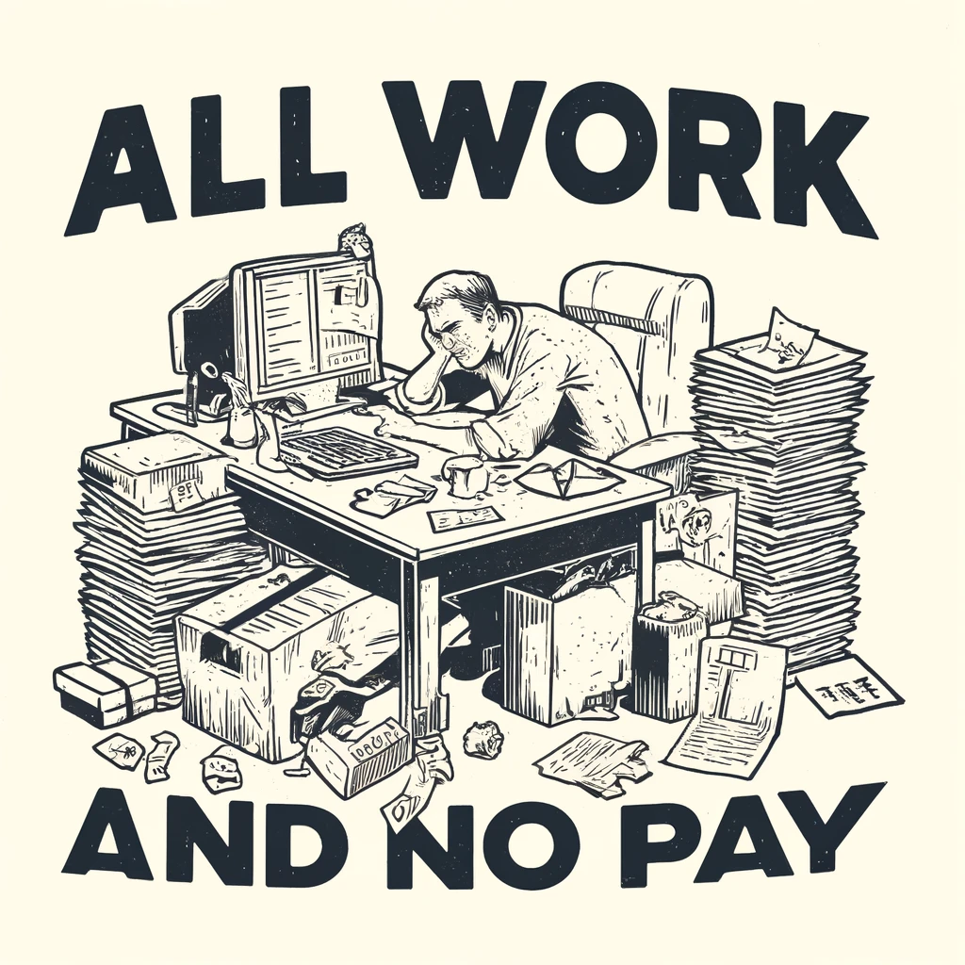


The Heroization and Exploitation of First-gen College Students
Shuang Wu
UC San Diego
Peter Belmi
University of Virginia
AOM 2024

Slide 2

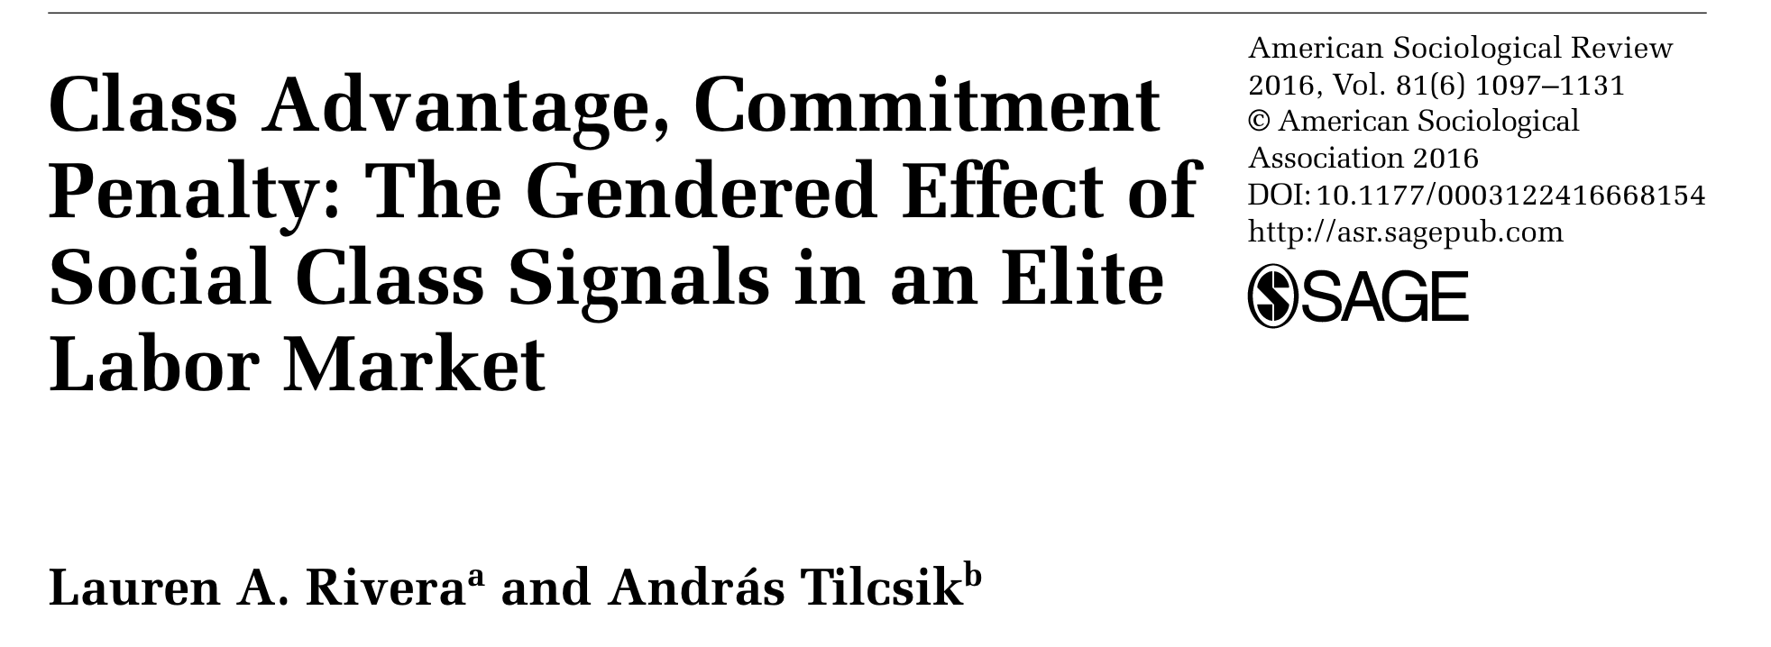
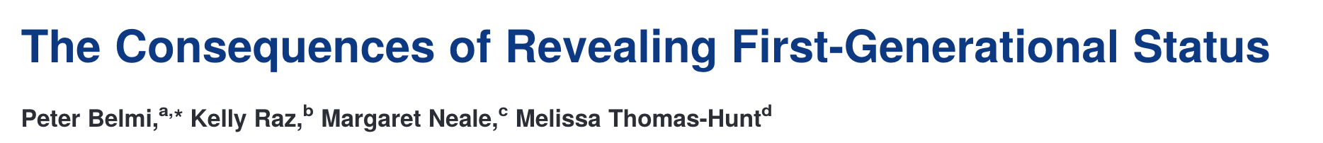
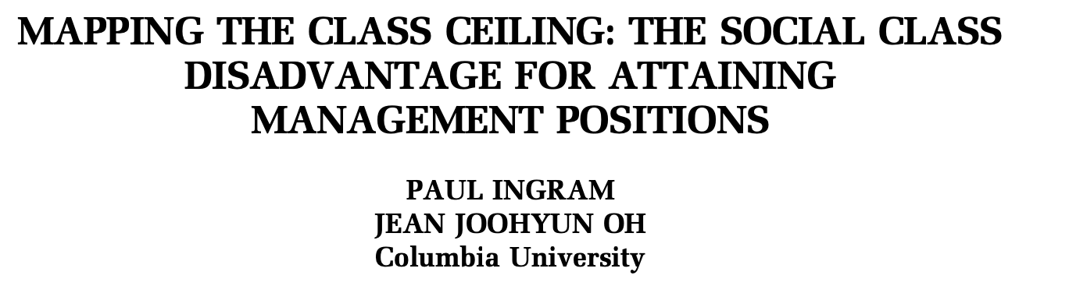
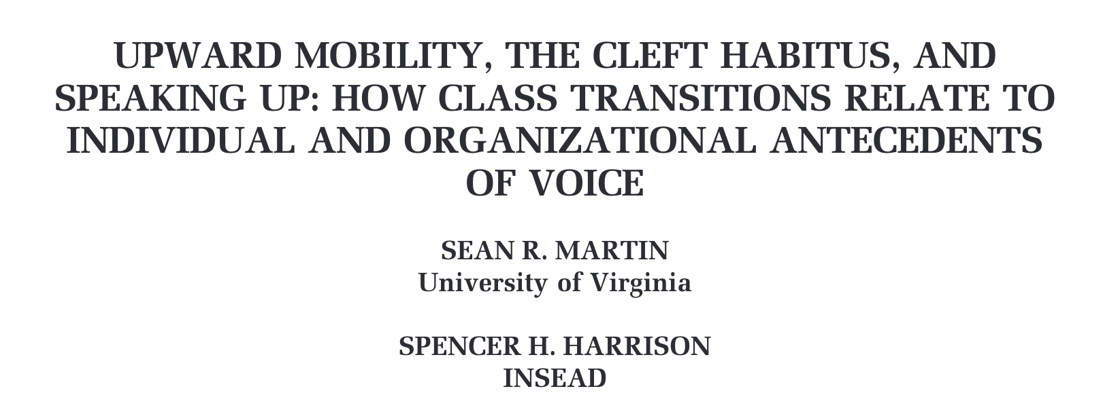
Notes:
Despite efforts to bridge social class disparities by making higher education more accessible, social class disparity persists as college students transition into the professional world.
This could be caused by multiple reasons. And a major contributing factor is...

Slide 3
Stereotypes
Negative stereotypes of individuals from lower social class origins:
Less competent, less cultural fit
Negative stereotypes of disadvantaged social groups are often complemented by positive ones
Women: less agentic, but warmer
Asians: less warm, but more hard-working
Positive stereotypes are system-justifying
More socially accepted , more prescriptive, more perenial
Funnel disadvantaged groups into low-status social roles
(Belmi et al., 2024; Czopp et al., 2015; Kay et al., 2007; Martin & Harrison, 2002; Rivera & Tilcsik, 2016)

Slide 4
Hypothesis 1:
Evaluators heroize first-gens more than continuing-gens.

Slide 5


What does “Hero” mean?
From the Greek word “heros”: protector or defender
The meaning has expanded to include more ordinary people.
(Allison & Goethals, 2011; Franco et al., 2011; Harper, 2010; Kinsella et al., 2015)

Slide 6
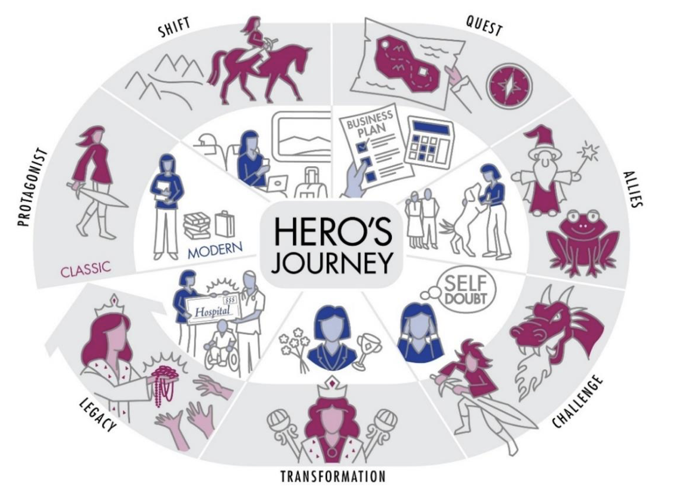
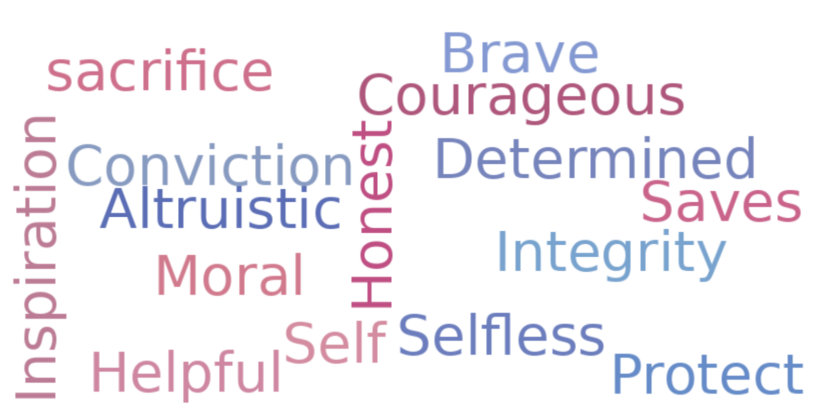
Who are considered heroes?
Those whose experience fits a hero’s journey narrative:
Those who possess prototypical traits:
Fig. 2. Joseph Campbell’s (1949) Hero’s Journey.
Figure credit: Kevin House. Reproduced from: Rogers et al., 2024
(Campbell, 1949; Kinsella et al., 2015; Rogers et al., 2023)
Notes:
E.g., inspiring, courageous, brave, saves
An ordinary hero (Protagonist) experiences a change in setting (Shift) that sets them towards a goal (Quest) during which they encounter friends (Allies) and obstacles (Challenges), but eventually triumphs and personally grows (Transformation), before returning home to benefit their community (Legacy).
They often overcome significant obstacles to pursue higher education and achieve their goals.
Their journey is often marked by challenges (e.g., financial constraints, navigating unfamiliar environments)
Despite these challenges, they demonstrate resilience, determination, and a strong work ethic.
They defy the odds to give back to their families and help their communities.

Slide 7
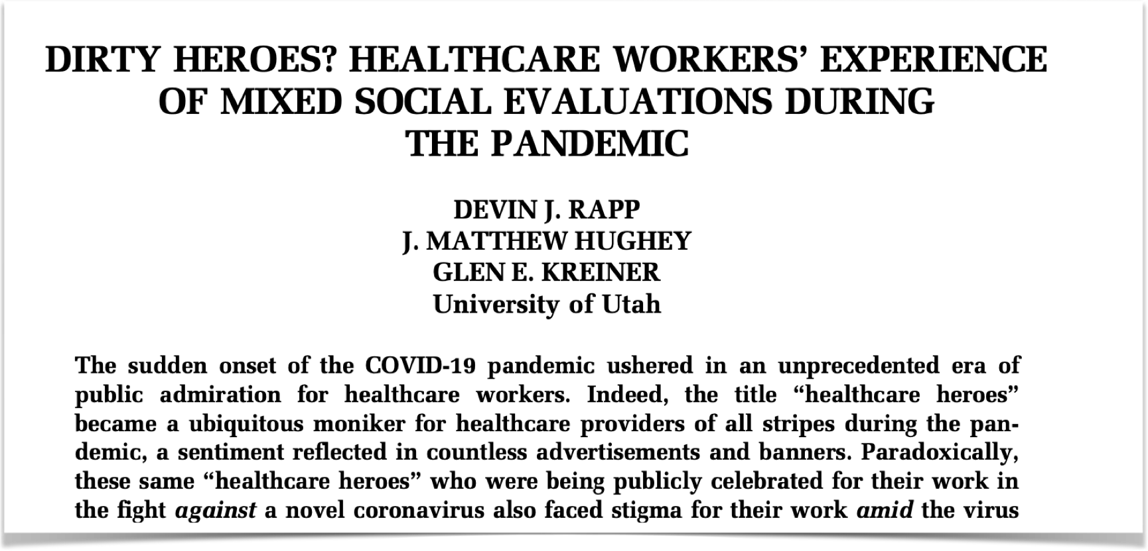
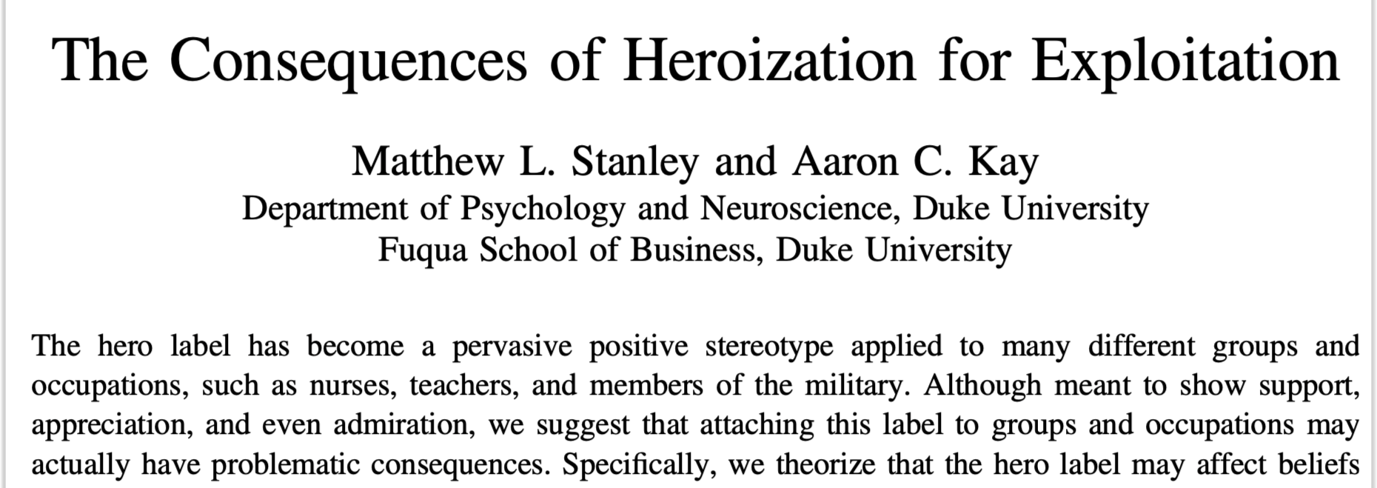
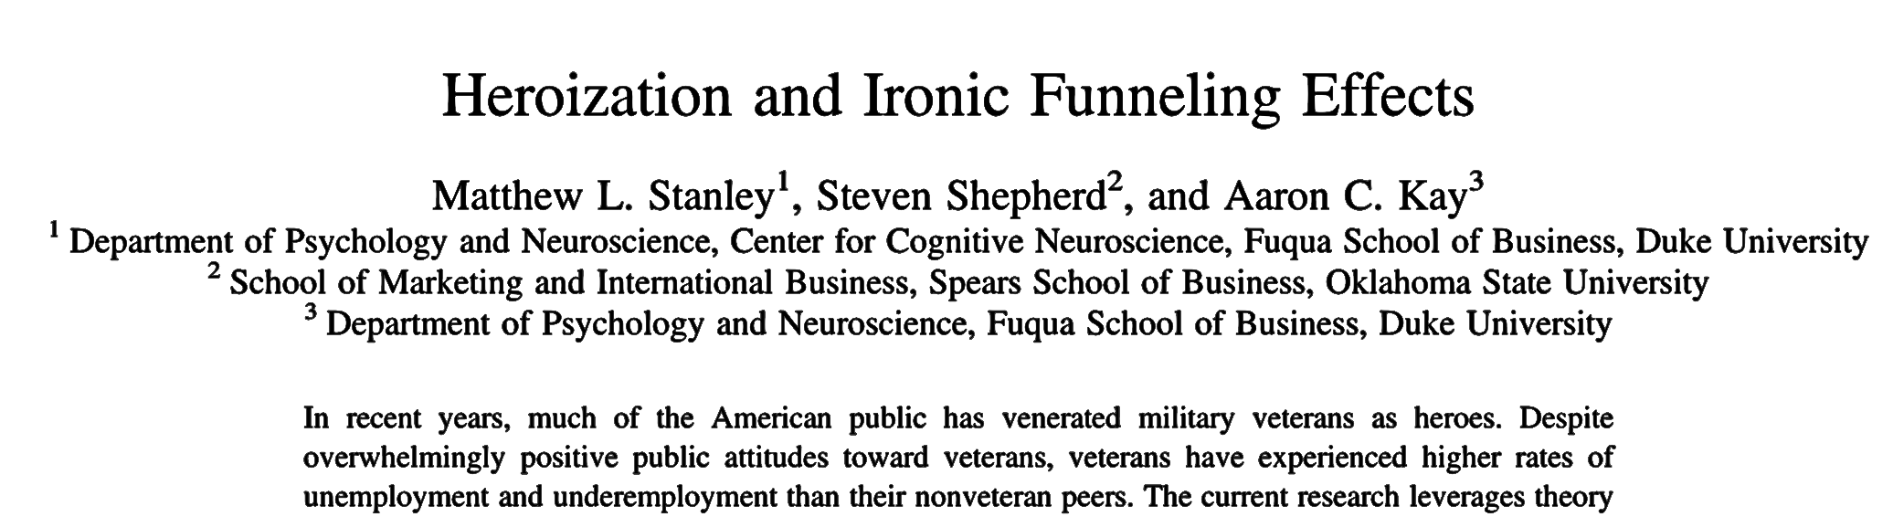
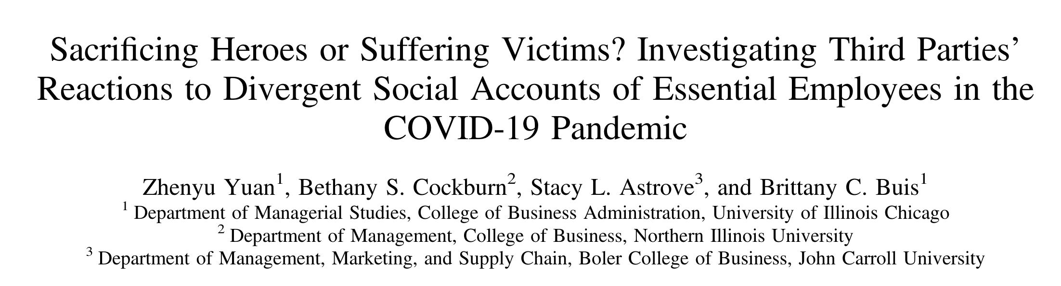
What’s bad about being heroized?
Heroes may be publicly celebrated but privately neglected.
People expect heroes to be more self-sacrificing and willing to be subjected to poor treatment in the service of a larger mission

Slide 8
Hypothesis 2:
Heroization mediates the effect of target first-gen status on evaluator’s exploitation of them.

Slide 9
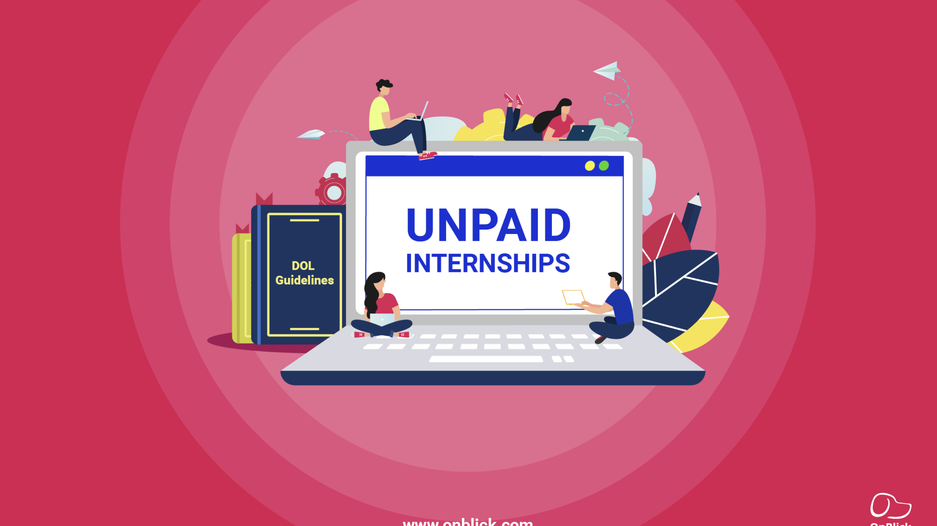
What is “exploitation”?
“To exploit someone is to take unfair advantage of them…to use another person’s vulnerability for one’s own benefit.”
Exploitation happens when employees are asked to do extra or demeaning work without sufficient tangible rewards.
(Snyder, 2010; Wertheimer, 1996; Zwolinski, 2012)

Slide 10
Is an unpaid internship exploitative?
REGULATION: Primary Beneficiary
No expectation of compensation
Provides training similar to educational settings
Not displace paid labor and provide significant educational benefits
Tied to formal educational program
Corresponds to academic calendar
Duration limited to the period which provides beneficial learning
Not entitled to paid job at the conclusion
REALITY
unpaid interns often engage in menial, clerical work than paid interns
Test is subjective, leading to inconsistent court decisions
Interns may not report due to fear for repercussion
Unpaid interns, without employee status, may be precluded from legal protection against employment discrimination and sexual harassment

Slide 11
Is an unpaid internship exploitative?
REGULATION: Primary Beneficiary
Provides training similar to educational settings
Not displace paid labor and provide significant educational benefits
Tied to formal educational program
Corresponds to academic calendar
Duration limited to the period which provides beneficial learning
No expectation of compensation
Not entitled to paid job at the conclusion
REALITY
Notes:
According to the US Department of Labor,
unpaid internships in for-profit companies need to pass a primary beneficiary test

Slide 12
Is an unpaid internship exploitative?
REGULATION: Primary Beneficiary
Provides training similar to educational settings
Not displace paid labor and provide significant educational benefits
Tied to formal educational program
Corresponds to academic calendar
Duration limited to the period which provides beneficial learning
No expectation of compensation
Not entitled to paid job at the conclusion
REALITY
unpaid interns often engage in menial, clerical work that does not contribute to professional development, and would otherwise be done by paid employees

Slide 13
Is an unpaid internship exploitative?
REGULATION: Primary Beneficiary
Provides training similar to educational settings
Not displace paid labor and provide significant educational benefits
Tied to formal educational program
Corresponds to academic calendar
Duration limited to the period which provides beneficial learning
No expectation of compensation
Not entitled to paid job at the conclusion
REALITY
Students must pay to enroll in a college class, and then they have to work for free.

Slide 14
Is an unpaid internship exploitative?
REGULATION: Primary Beneficiary
Provides training similar to educational settings
Not displace paid labor and provide significant educational benefits
Tied to formal educational program
Corresponds to academic calendar
Duration limited to the period which provides beneficial learning
No expectation of compensation
Not entitled to paid job at the conclusion
REALITY
Many unpaid internships implicitly create expectations of future job offers “if things go right”

Slide 15

Overview of Experiments
Experiment 1: survey experiment (heroization)
Experiment 2: survey experiment (heroization and exploitation)
Experiment 3: audit study (exploitation)
Are these effects moderated by race?

Slide 16
Experiment 1
N = 1,203 participants from Prolific (gender-balanced)
Criteria: (1) based in the United States; (2) is at least 25 years old; (3) employed full-time or part-time; (4) is not a student; (5) has a college degree
Mean age = 42.46 (SD = 12.18)
71% White Americans, 9% Black/African Americans, 9% Asian Americans, 3% Hispanic/Latin Americans, 8% multiracial or other
Excluded 87 who failed attention checks
2 (candidate status: First-Gen vs. Control) × 4 (candidate race: Asian vs. Black vs. Latino vs. White) between-subjects design

Slide 17
EXP 1 Design
Control
First-Gen
Bradford Anderson
Control
Bradford Anderson
First-Gen
White
Luke Zhang
Control
Luke Zhang
First-Gen
Asian
Lamar Washington
Control
Lamar Washington
First-Gen
Black
Juan Gonzalez
Control
Juan Gonzalez
First-Gen
Latino

Slide 18
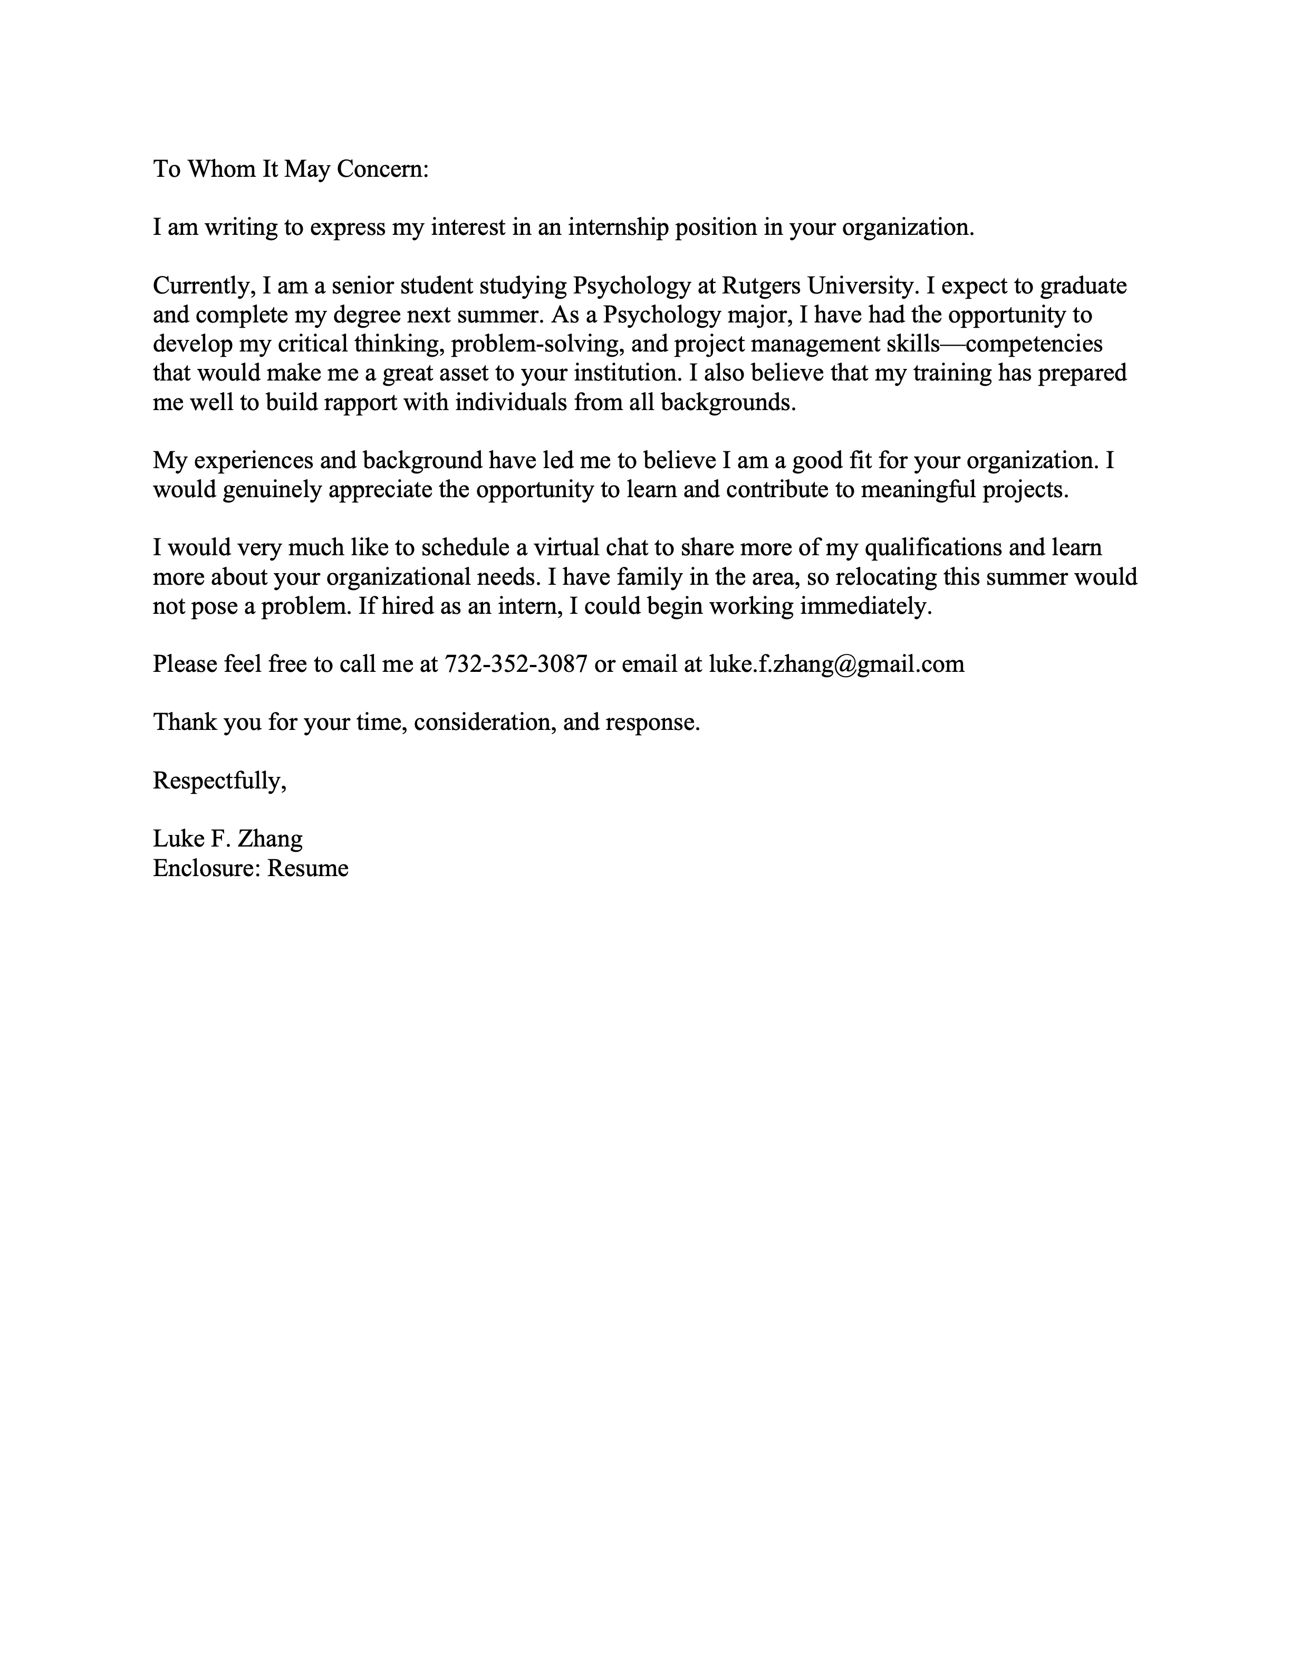
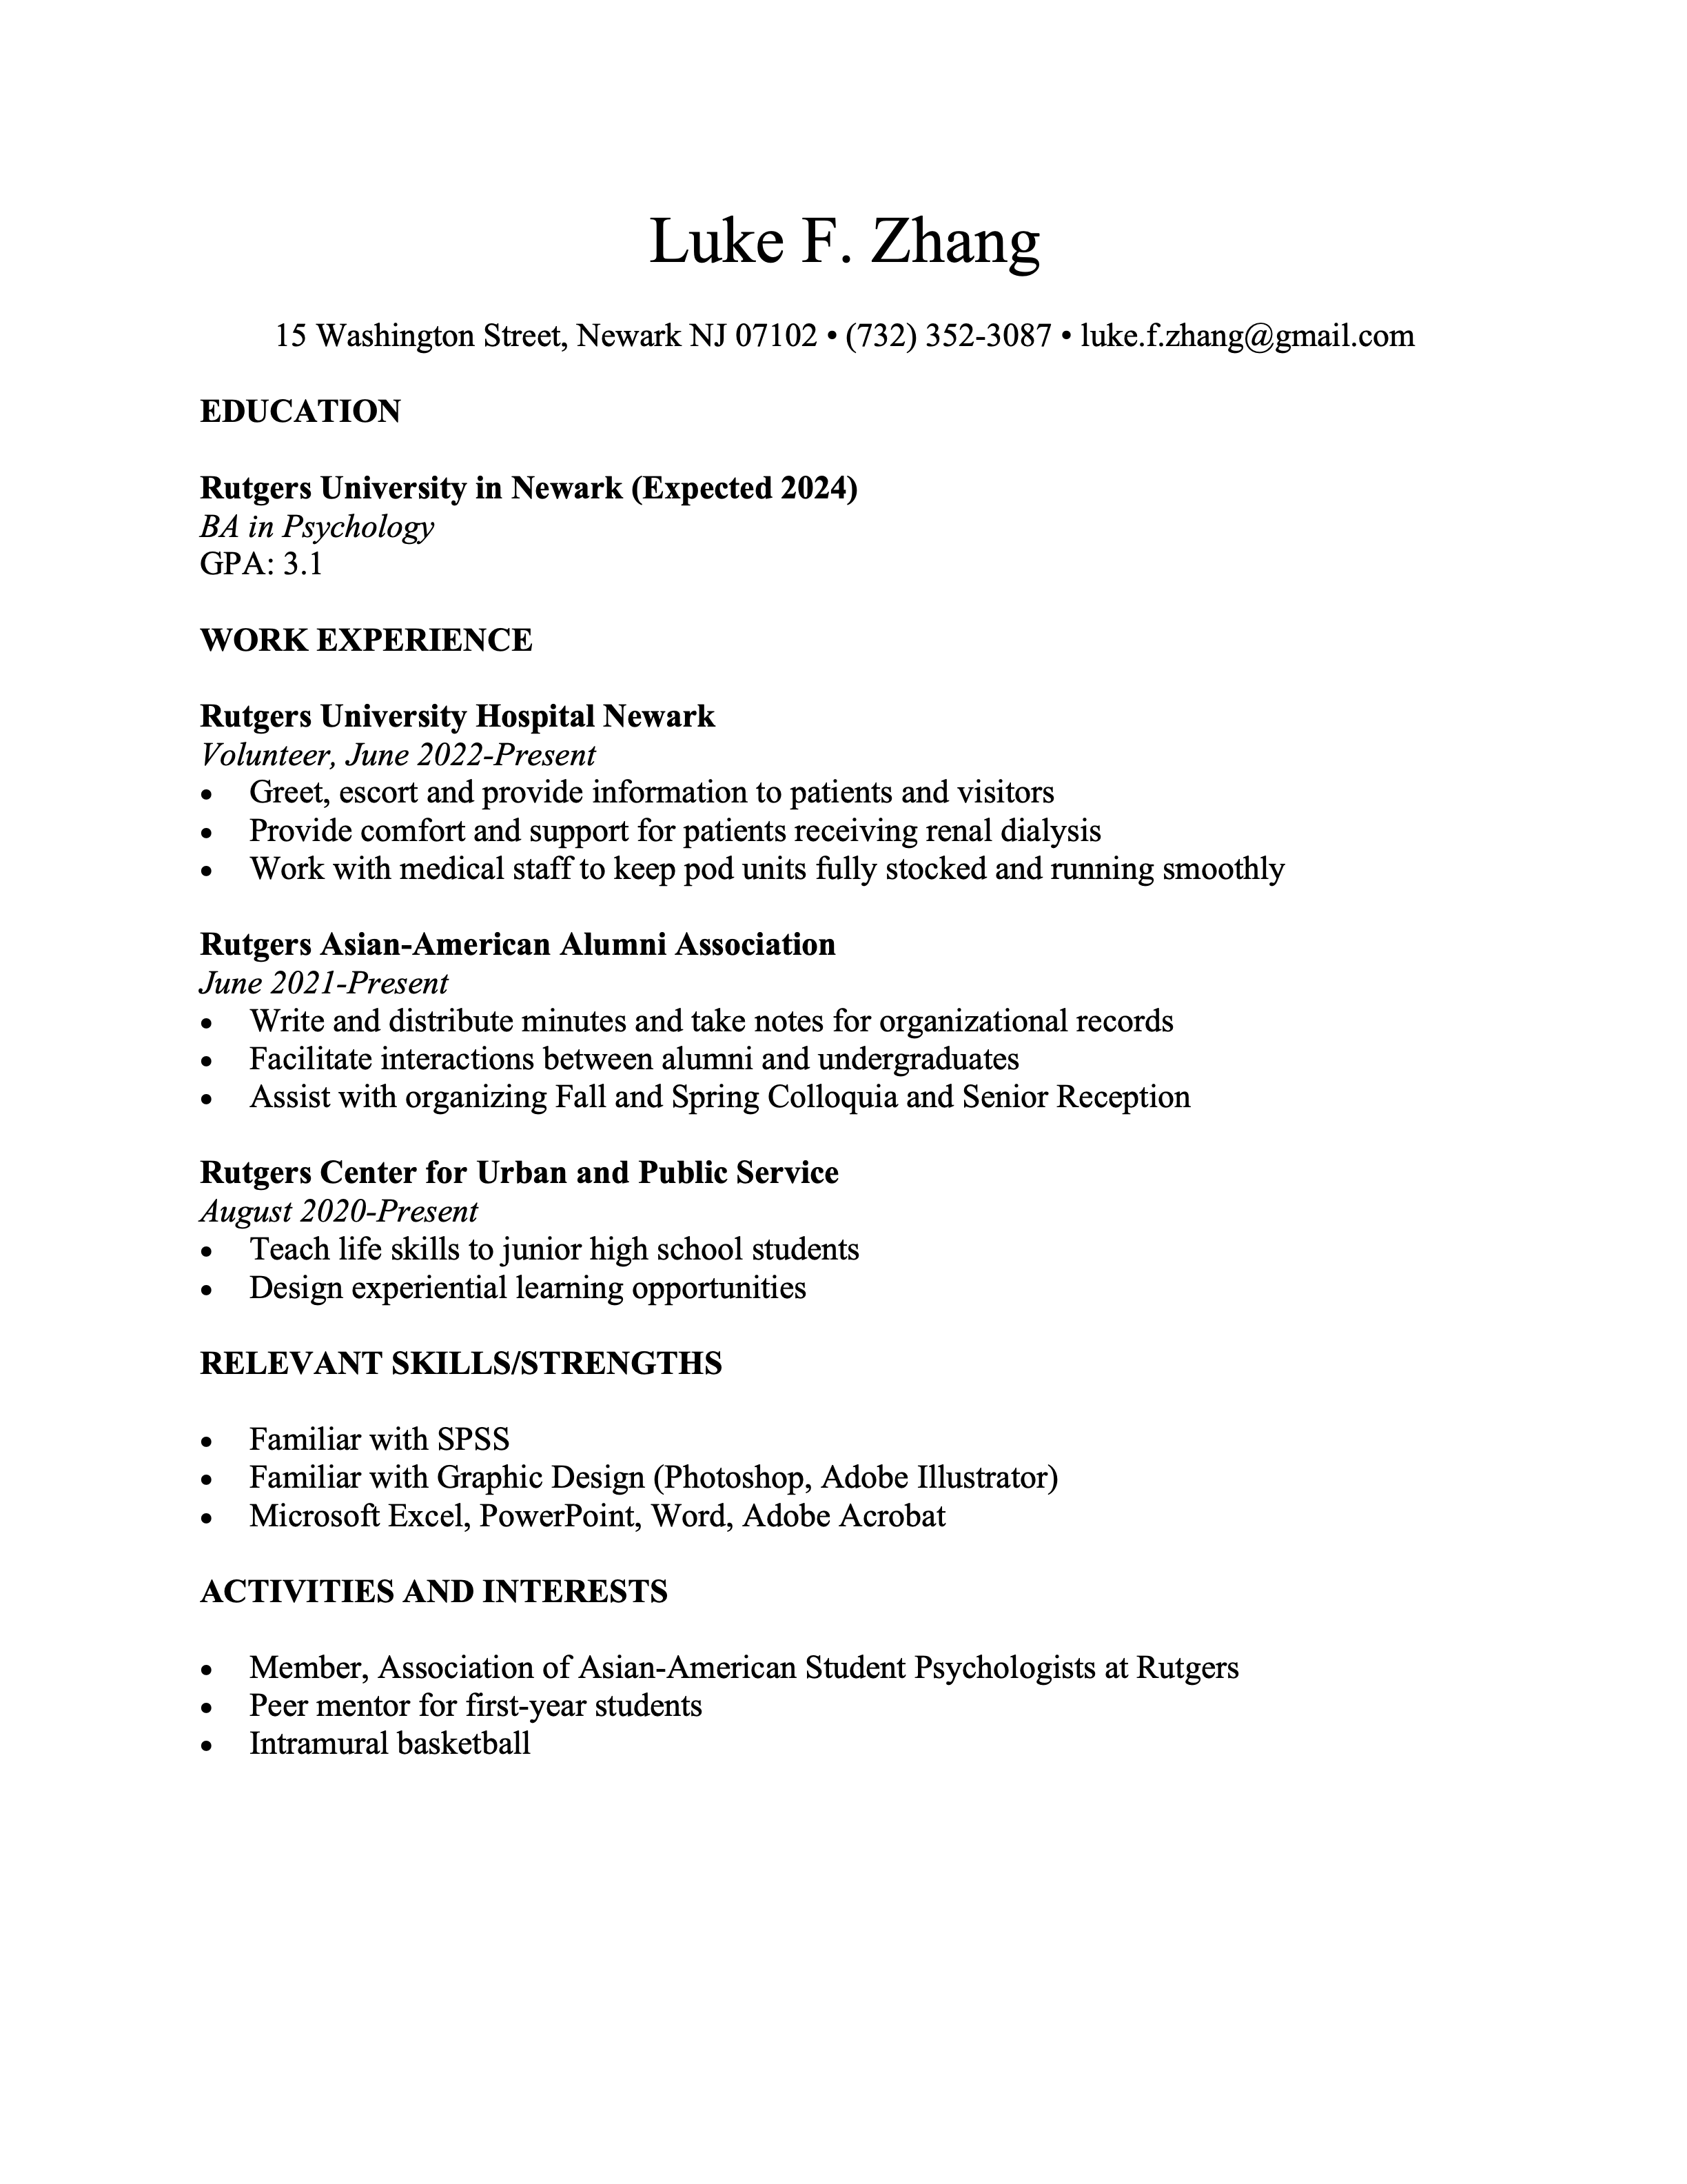
EXP 1 Control Conditions
“Peer mentor for first-year students”

Slide 19
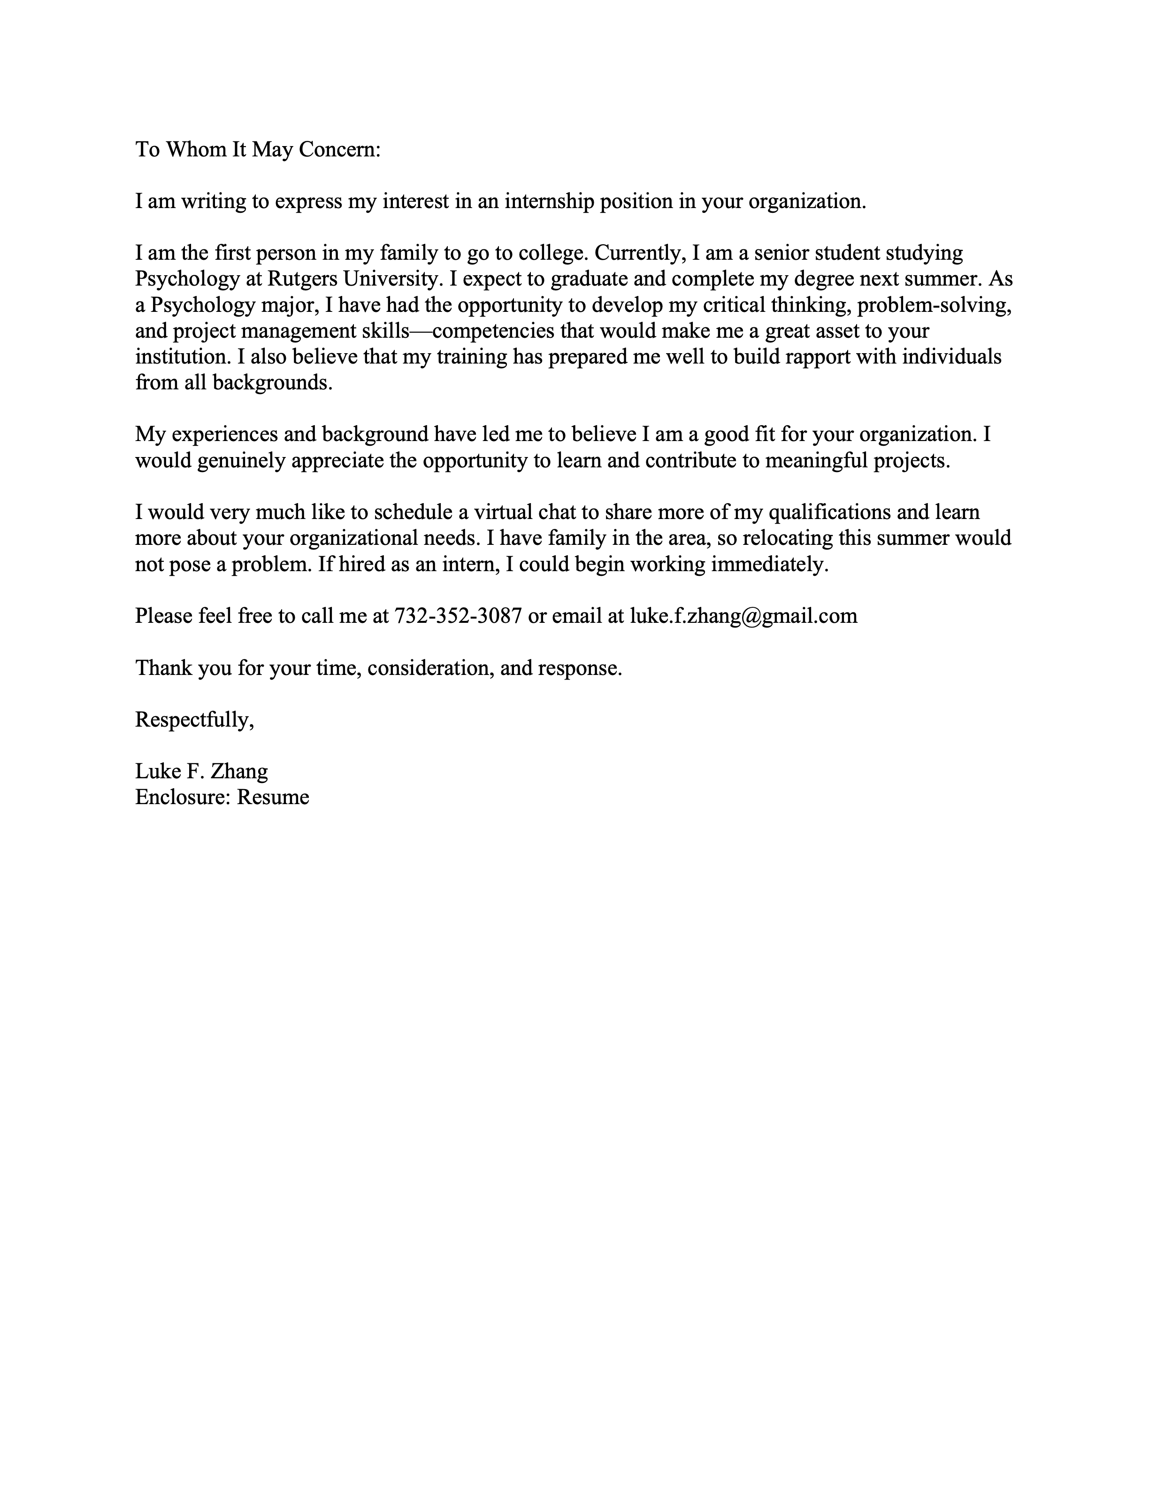
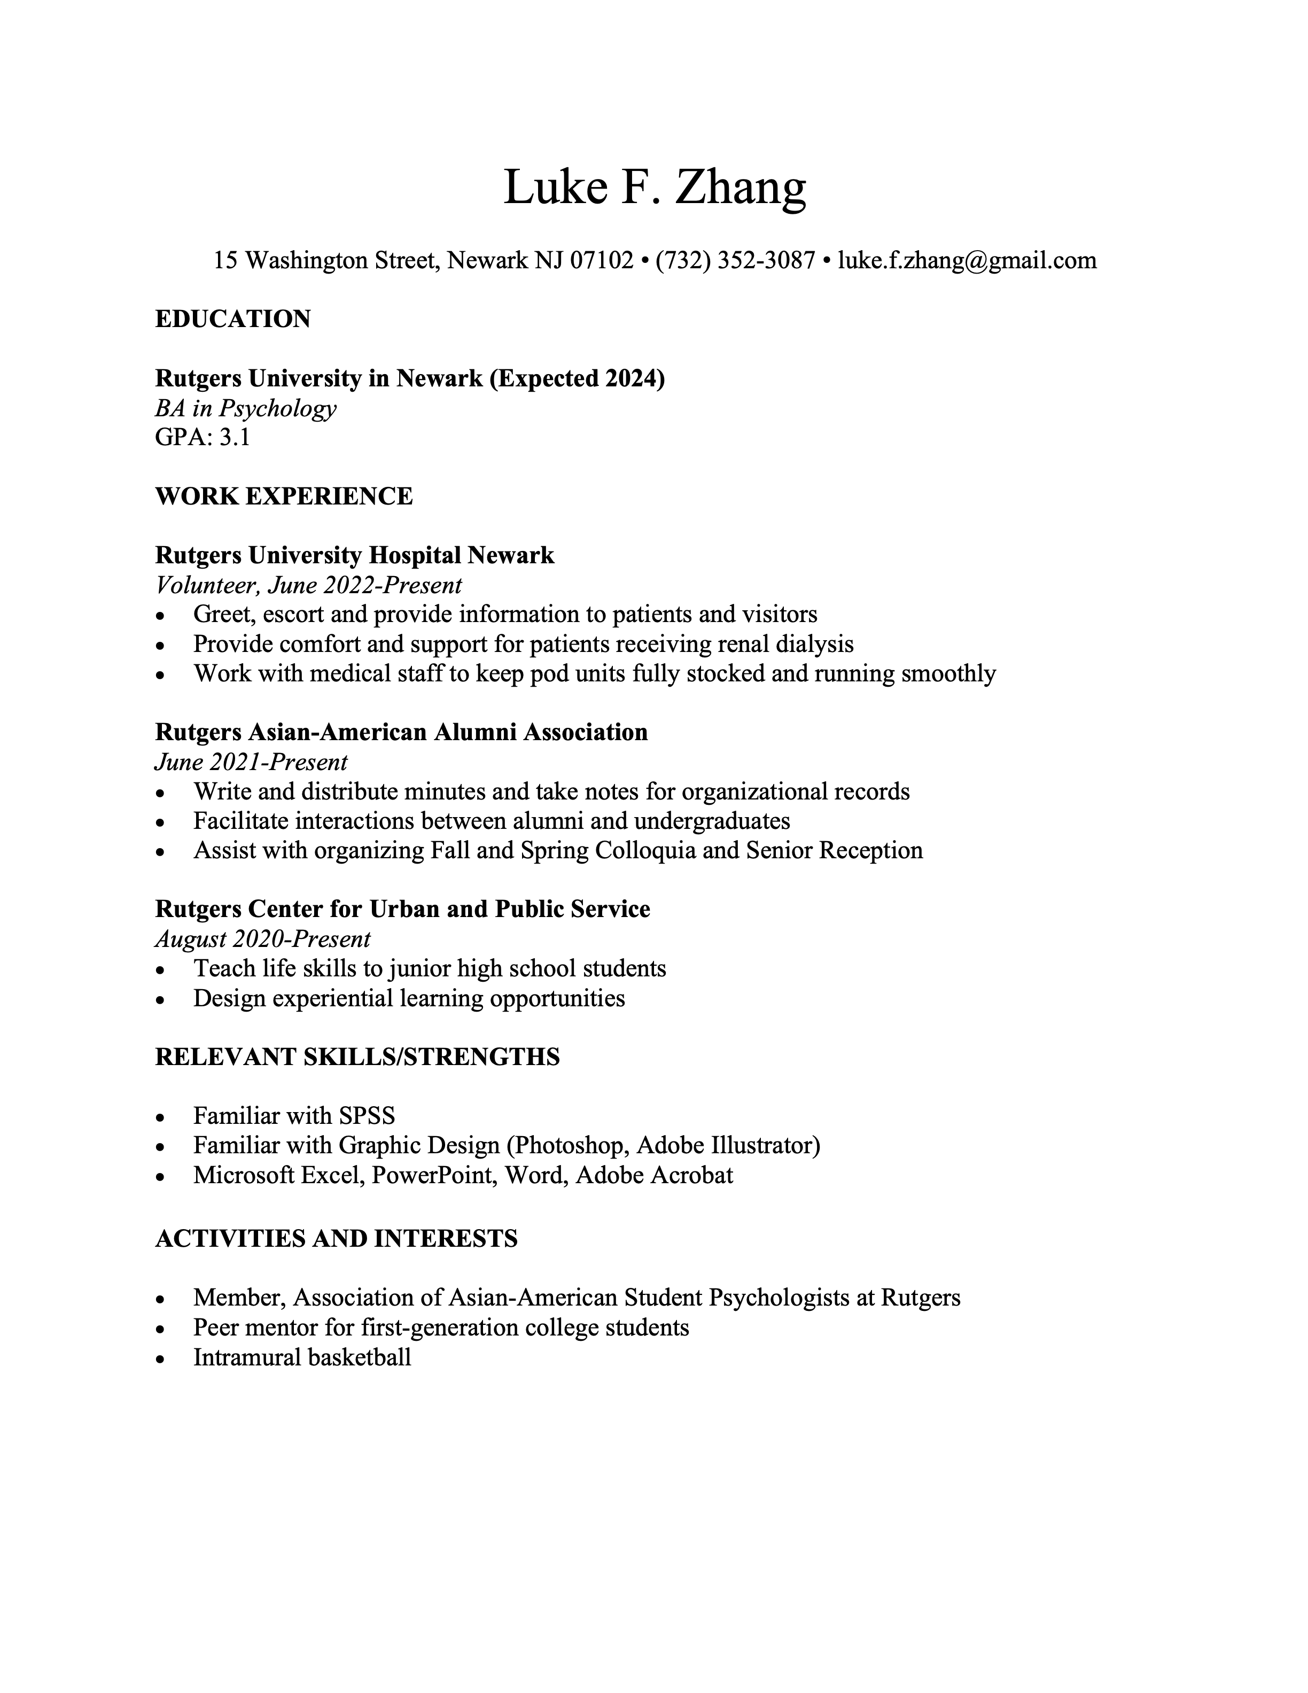
EXP 1 First-Gen Conditions
“I am the first person in my family to go to college.”
“Peer mentor for first-generation college students”

Slide 20
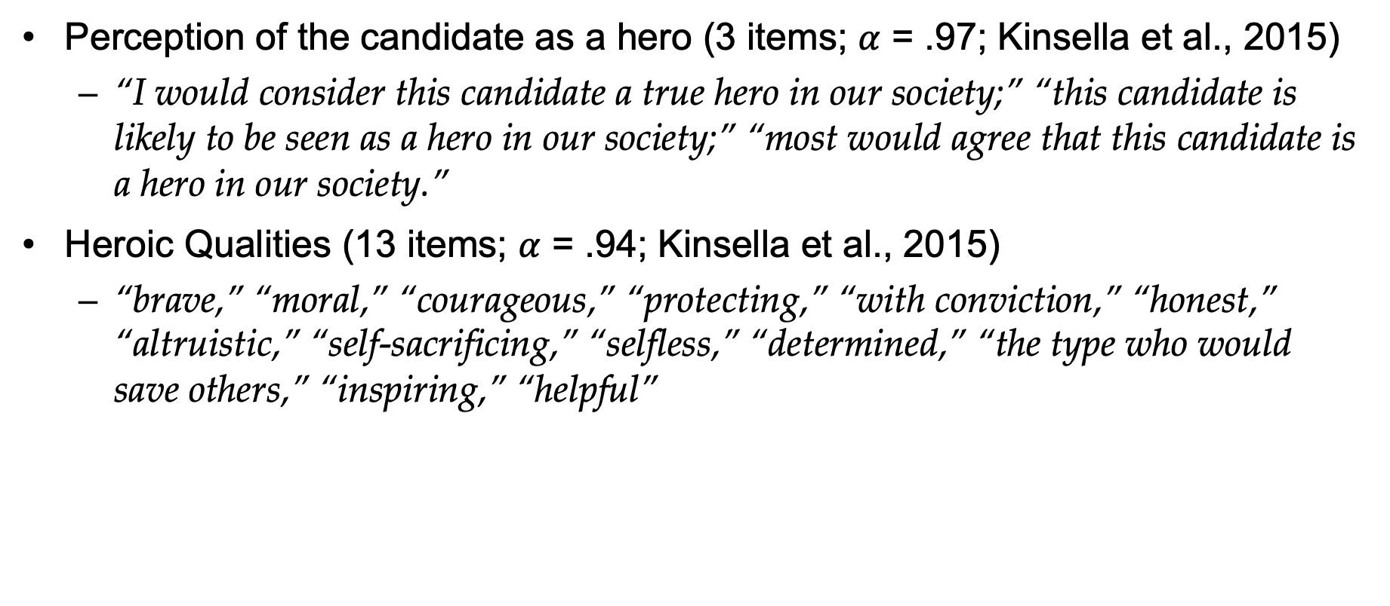
EXP 1 Measures
Perception of the candidate as a hero (3 items; $α$ = .97; Kinsella et al., 2015)
“I would consider this candidate a true hero in our society;” “this candidate is likely to be seen as a hero in our society;” “most would agree that this candidate is a hero in our society.”
Heroic Qualities (13 items; $α$ = .94; Kinsella et al., 2015)
“brave,” “moral,” “courageous,” “protecting,” “with conviction,” “honest,” “altruistic,” “self-sacrificing,” “selfless,” “determined,” “the type who would save others,” “inspiring,” “helpful”

Slide 21
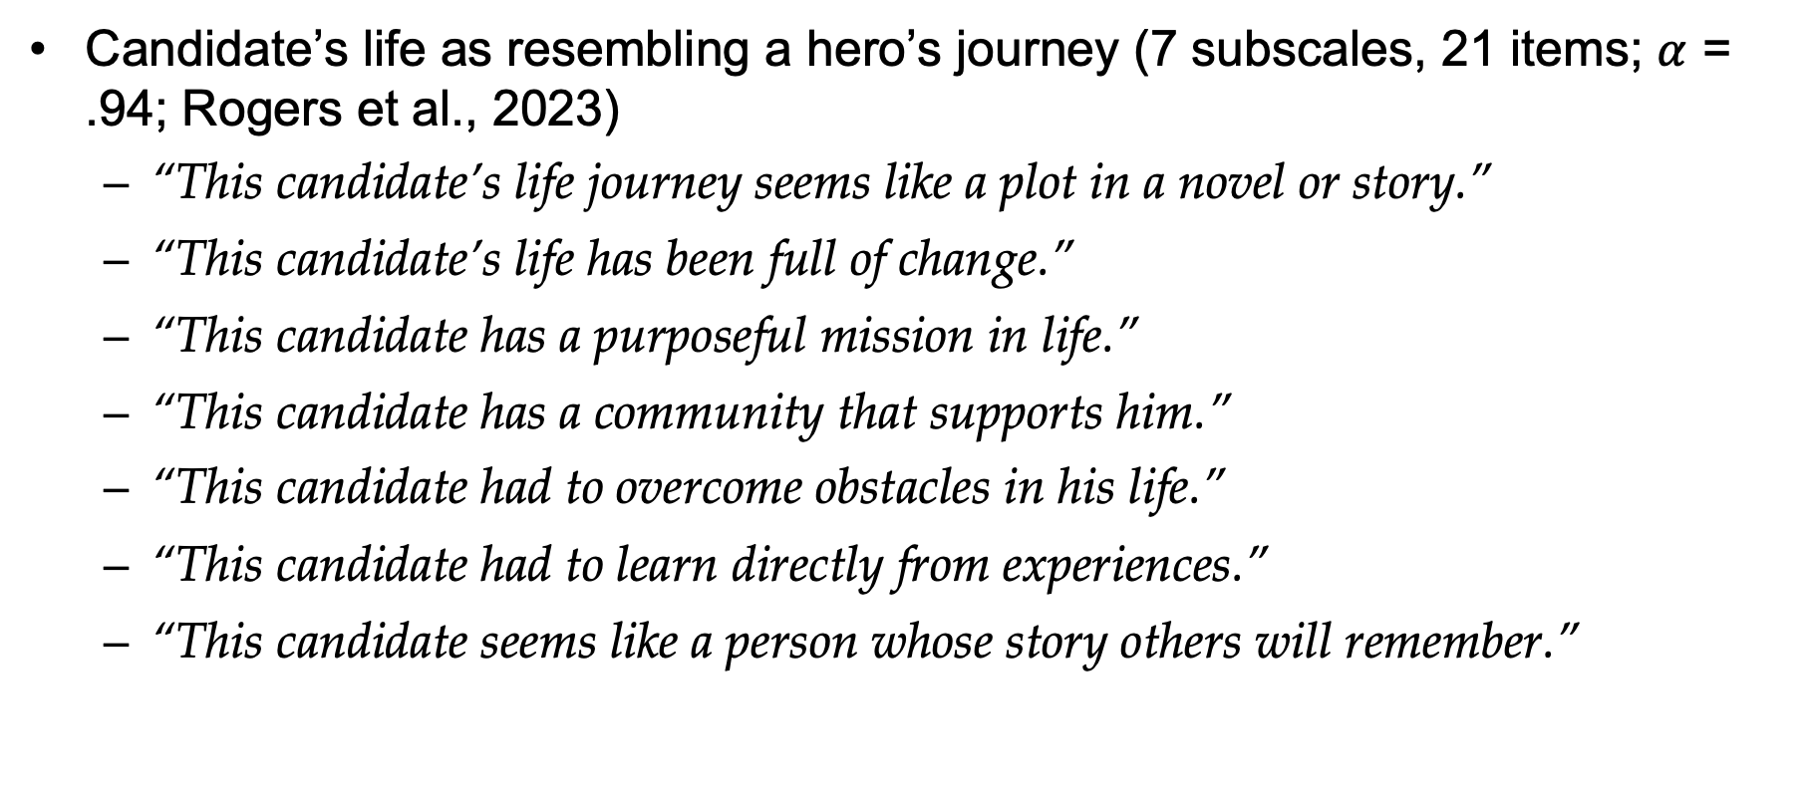
EXP 1 Measures
Candidate’s life as resembling a hero’s journey (7 subscales, 21 items; $α$ = .94; Rogers et al., 2023)
“This candidate’s life journey seems like a plot in a novel or story.”
“This candidate’s life has been full of change.”
“This candidate has a purposeful mission in life.”
“This candidate has a community that supports him.”
“This candidate had to overcome obstacles in his life.”
“This candidate had to learn directly from experiences.”
“This candidate seems like a person whose story others will remember.”

Slide 22
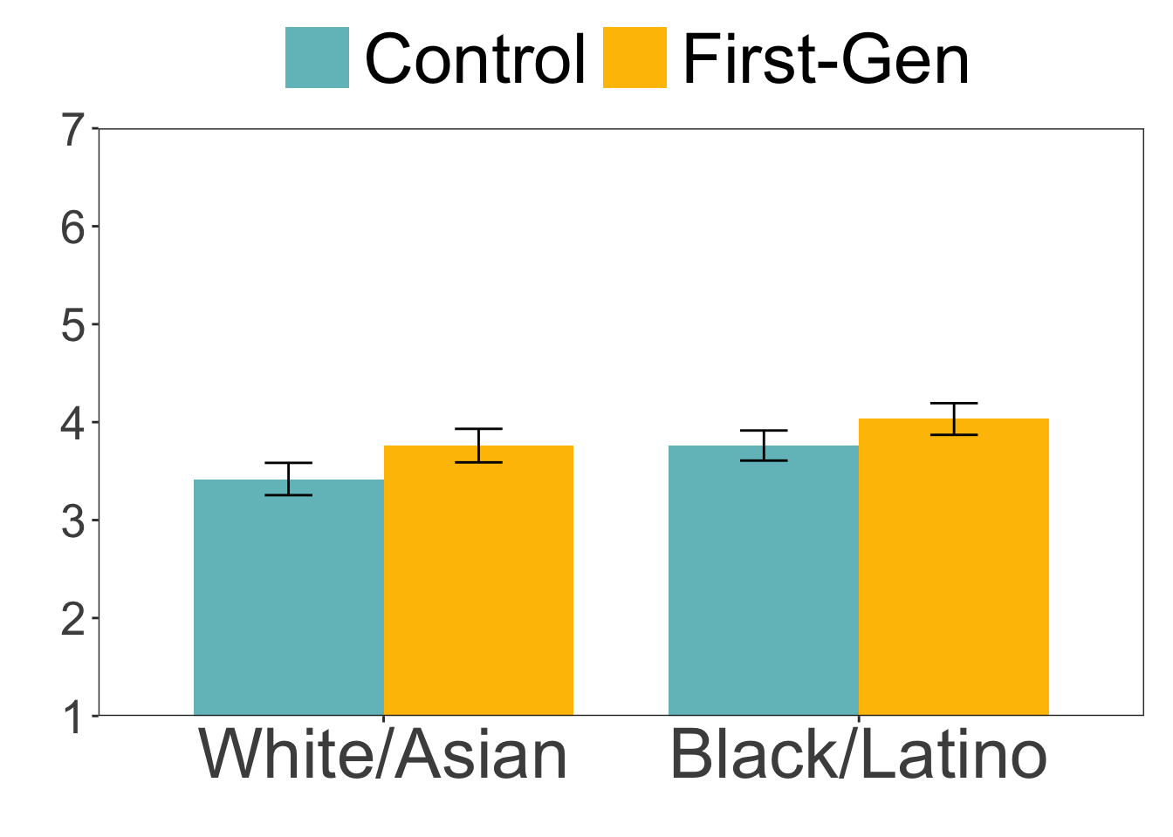
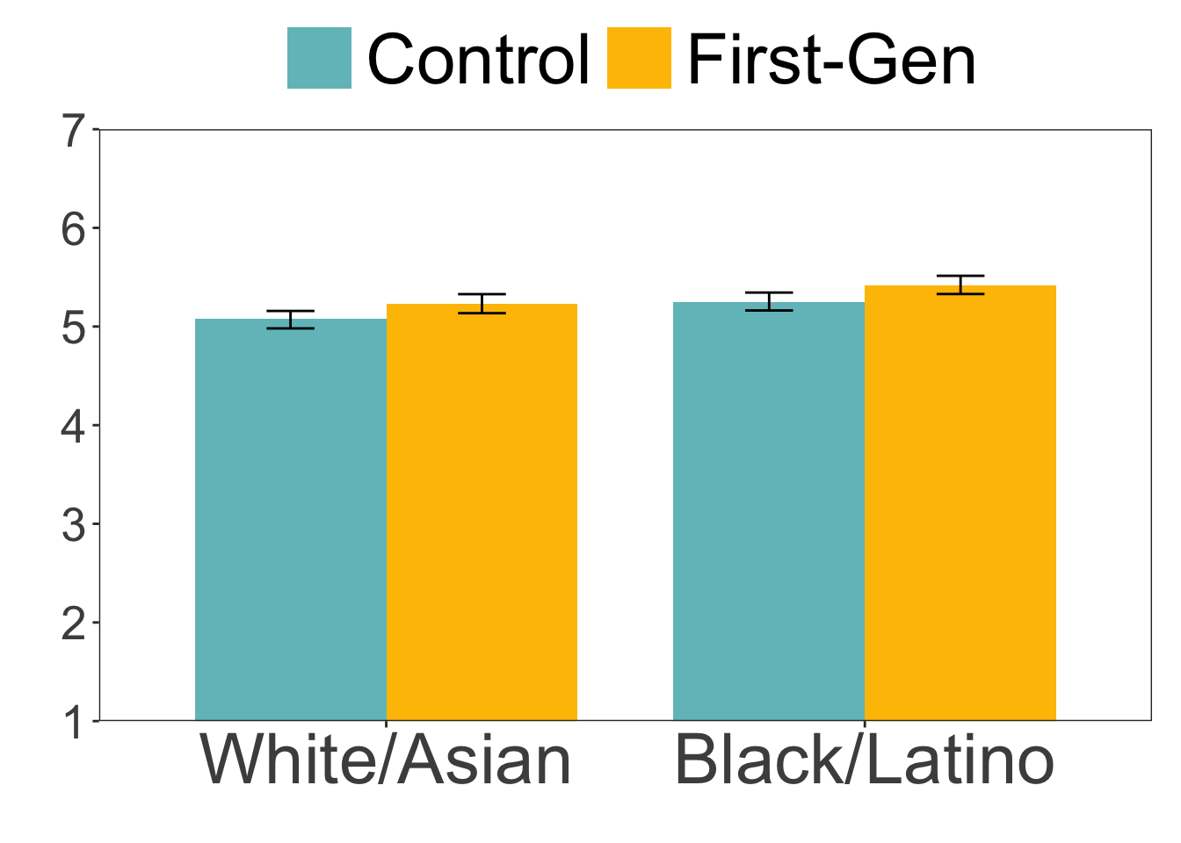
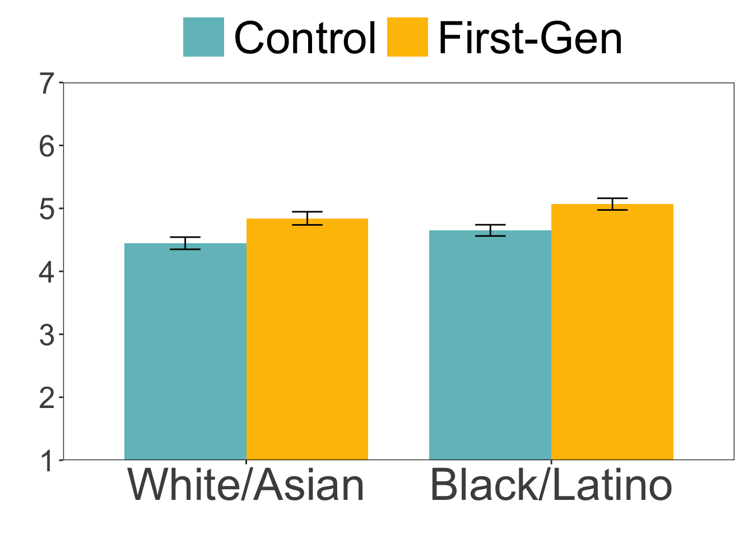
EXP 1 Results
Hero Label
Heroic Qualities
Hero’s Journey
First-gen: b = 0.16, SE = 0.04, t(1112) = 3.59, p < .001
URM: b = 0.16, SE = 0.04, t(1112) = 3.59, p < .001
Interaction: b = -0.02, SE = 0.04, t(1112) = -0.42, p = .677
First-gen: b = 0.08, SE = 0.02, t(1112) = 3.38, p < .001
URM: b = 0.09, SE = 0.02, t(1112) = 3.85, p < .001
Interaction: b = 0.004, SE = 0.02, t(1112) = 0.19, p = .852
First-gen: b = 0.20, SE = 0.03, t(1112) = 8.06, p < .001
URM: b = 0.11, SE = 0.03, t(1112) = 4.32, p < .001
Interaction: b = 0.01, SE = 0.03, t(1112) = 0.25, p = .805
Notes:
“brave,” “moral,” “courageous,” “protecting?,” “with conviction,” “honest,” “altruistic,” “self-sacrificing?,” “selfless,” “determined,” “the type who would save others,” “inspiring,” “helpful”
An ordinary hero (Protagonist) experiences a change in setting (Shift) that sets them towards a goal (Quest) during which they encounter friends (Allies) and obstacles (Challenges), but eventually triumphs and personally grows (Transformation), before returning home to benefit their community (Legacy).

Slide 23
Experiment 2
N = 1,353 participants from Prolific (gender-balanced)
Criteria: (1) based in the United States; (2) is at least 25 years old; (3) employed full-time or part-time; (4) is not a student; (5) has a college degree
Mean age = 38.87 (SD = 11.32)
62% White Americans, 16% Black/African Americans, 9% Asian Americans, 4% Hispanic/Latin Americans, 9% multiracial or other
Excluded 118 who failed attention checks
2 (candidate status: First-Gen vs. Control) × 4 (candidate race: Asian vs. Black vs. Latino vs. White) between-subjects design

Slide 24
EXP 2 Unpaid Internship Scenario
REGULATION: Primary Beneficiary
No expectation of compensation
Provides training similar to educational settings
Not displace paid labor and provide significant educational benefits
Tied to formal educational program
Corresponds to academic calendar
Duration limited to the period which provides beneficial learning
Not entitled to paid job at the conclusion

Slide 25

EXP 2 Unpaid Internship Scenario
REGULATION: Primary Beneficiary
No expectation of compensation
Provides training similar to educational settings
Not displace paid labor and provide significant educational benefits
Tied to formal educational program
Corresponds to academic calendar
Duration limited to the period which provides beneficial learning
Not entitled to paid job at the conclusion
This candidate has confirmed that he is aware the internship is unpaid.

Slide 26

EXP 2 Unpaid Internship Scenario
REGULATION: Primary Beneficiary
No expectation of compensation
Provides training similar to educational settings
Not displace paid labor and provide significant educational benefits
Tied to formal educational program
Corresponds to academic calendar
Duration limited to the period which provides beneficial learning
Not entitled to paid job at the conclusion
They may need to work long hours and take on many company responsibilities to help complete important deliverables on time.

Slide 27
EXP 2 Unpaid Internship Scenario
REGULATION: Primary Beneficiary
No expectation of compensation
Provides training similar to educational settings
Not displace paid labor and provide significant educational benefits
Tied to formal educational program
Corresponds to academic calendar
Duration limited to the period which provides beneficial learning
Not entitled to paid job at the conclusion
You are looking for students willing to work for an unpaid internship in exchange for valuable experience, resume building and the opportunity to be part of the company down the road after the internship if “things go right.”

Slide 28
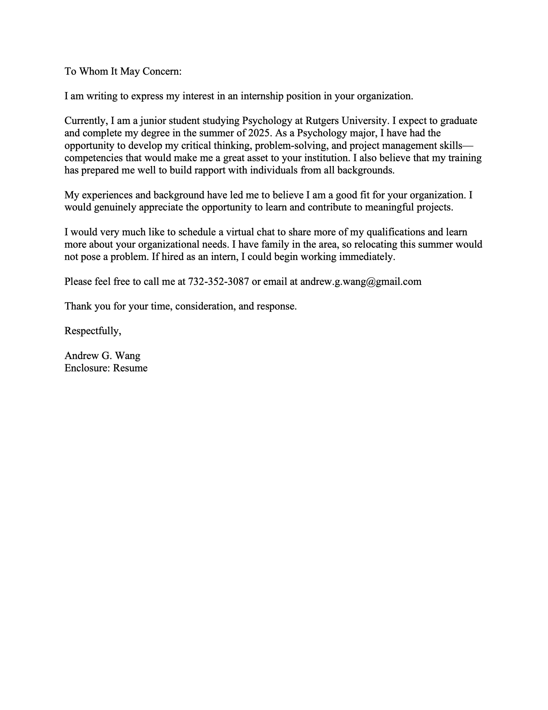
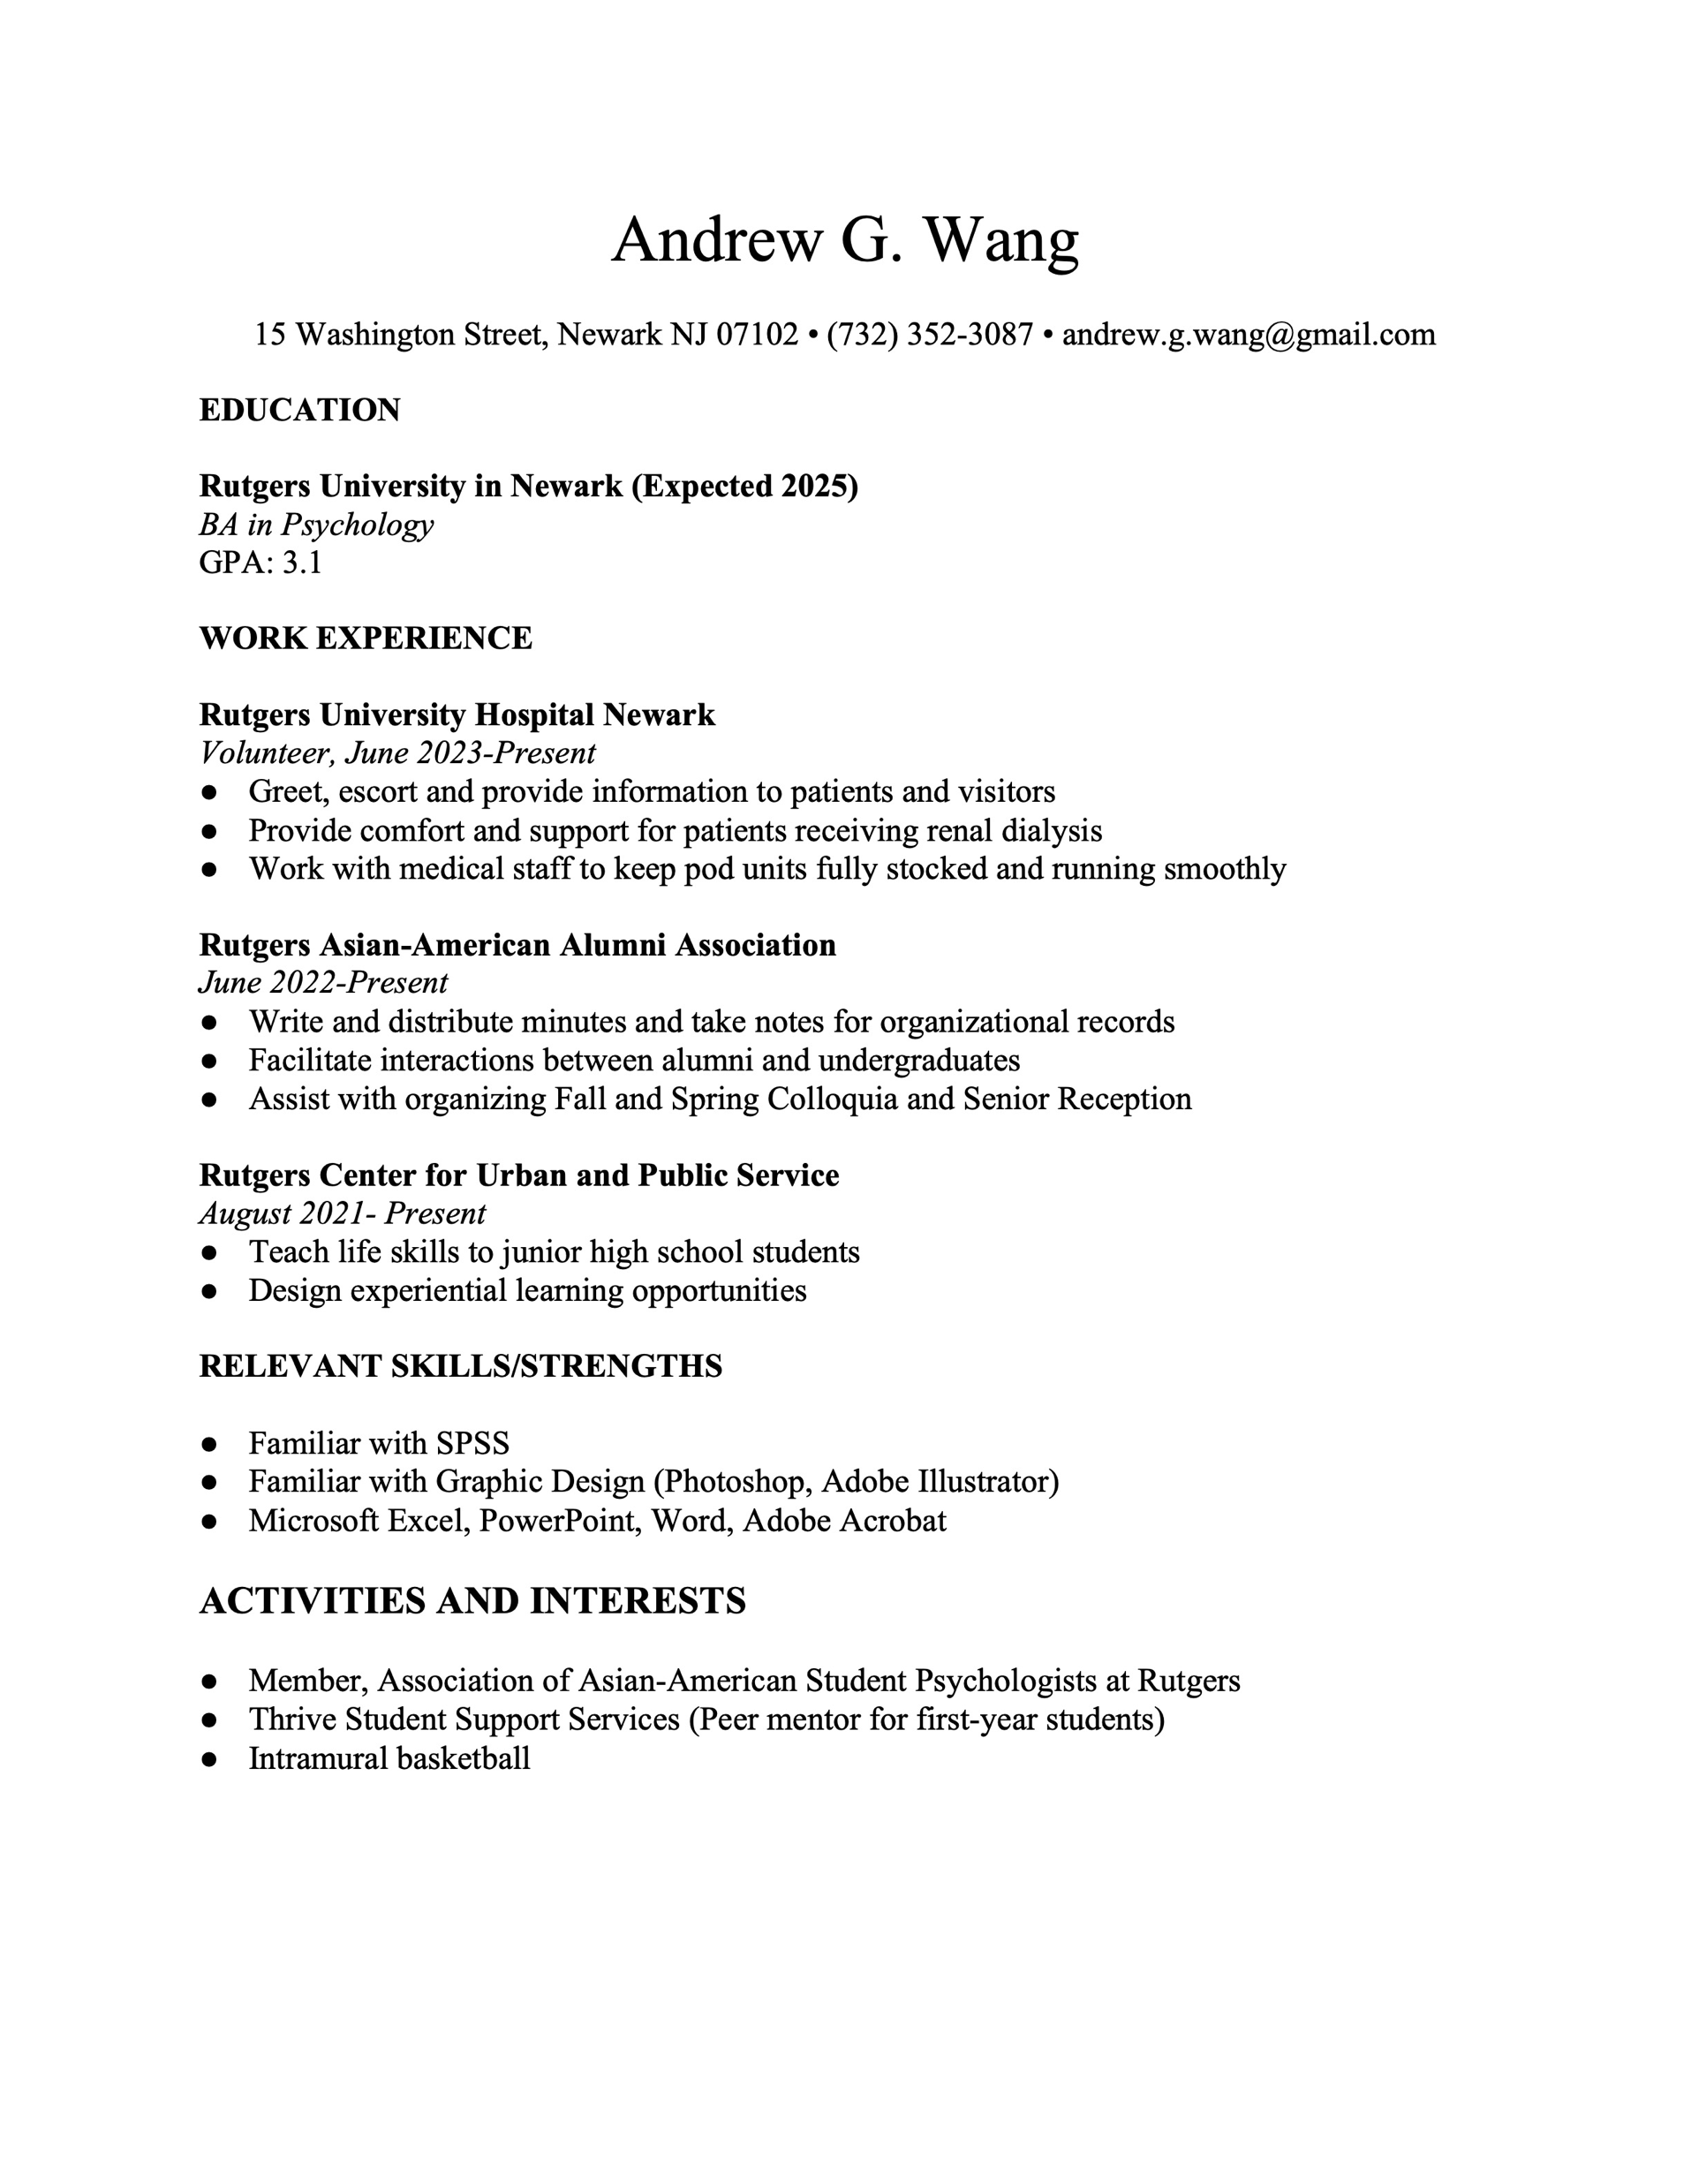
EXP 2 Control Conditions
“Peer mentor for first-year students”

Slide 29
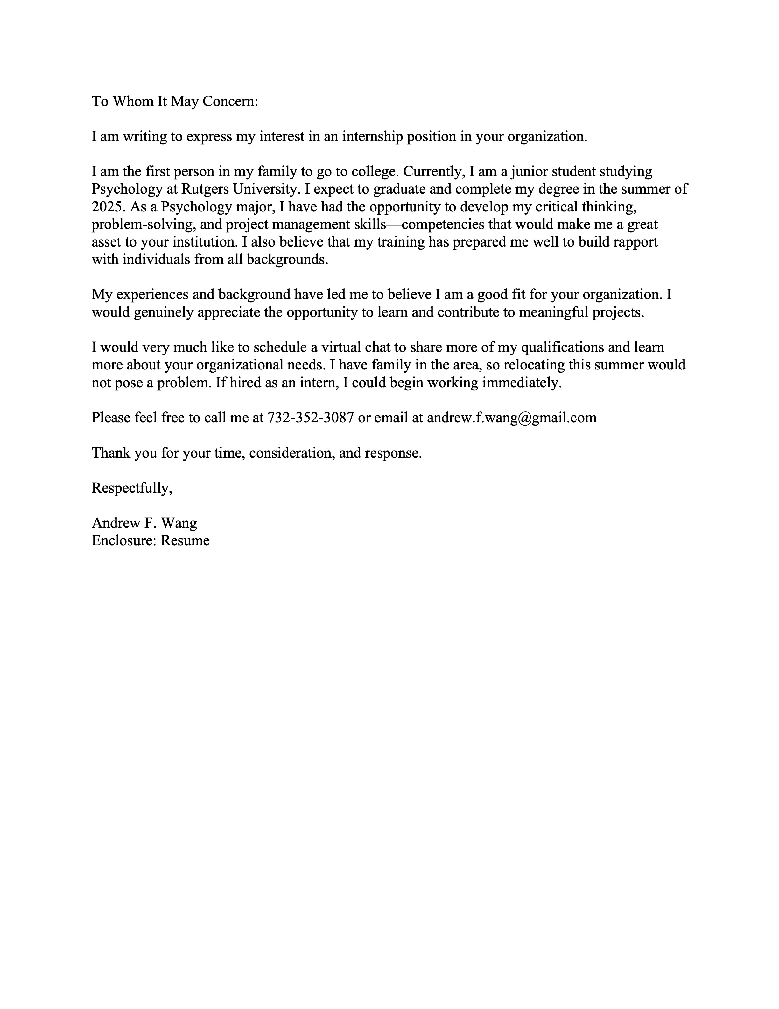
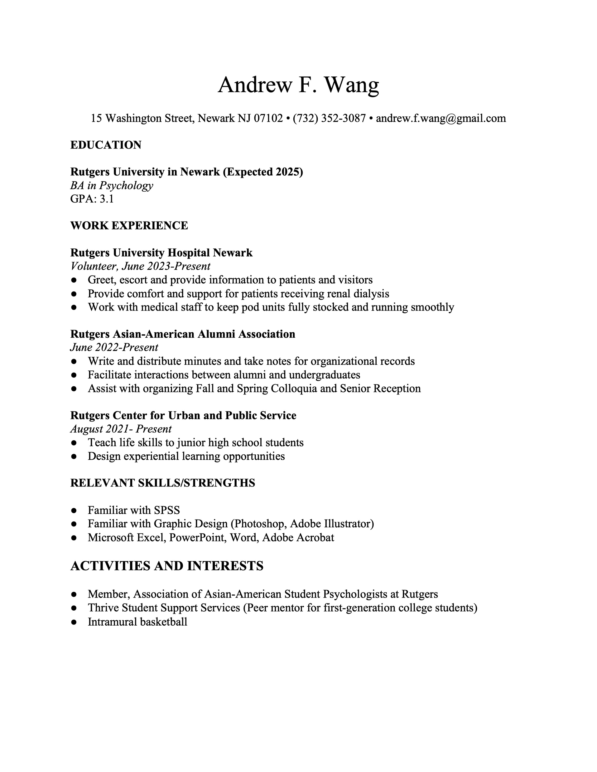
EXP 2 First-Gen Conditions
“I am the first person in my family to go to college.”
“Peer mentor for first-generation college students”

Slide 30
EXP 2 Design
Control
First-Gen
James Hansen
Control
James Hansen
First-Gen
White
Andrew Wang
Control
Andrew Wang
First-Gen
Asian
Marcus Johnson
Control
Marcus Johnson
First-Gen
Black
Julian Rodriguez
Control
Julian Rodriguez
First-Gen
Latino

Slide 31
EXP 2 Unpaid Internship Scenario
Imagine leaving your job to join a growing startup “Chomp”… You were hired Chomp’s business development director…You will play a critical role in getting the startup off the ground.
Like most startups, your company faces a range of challenges. The most pressing one is operating on a limited pool of financial resources and head count restrictions from your investors. Consequently, the startup has been finding it difficult to hire top talent and complete important deliverables on time. You often compete with larger companies that can offer higher salaries and more benefits.
In the early stages of a startup, everyone often needs to make sacrifices. They may need to work long hours and take on many company responsibilities. However, you believe that with hard work and the right strategies, the potential rewards for you, your team and society are vast.

Slide 32
EXP 2 Unpaid Internship Scenario
Today, you will evaluate the internship application materials from one candidate. This candidate has confirmed that he is aware the internship is unpaid.
You have found that even for unpaid internships, it’s important to be thoughtful about who to bring into Chomp. Candidates who are not adaptive, resourceful, collaborative, or passionate about making positive social impact often do not fully engage in the experience. So, although this is an unpaid internship, you should bring in candidates only if they could be a good fit with the needs of the company. Please click next to see the person’s resume and application materials.
Notes:
You are looking for students willing to work for an unpaid internship in exchange for valuable experience, resume building and the opportunity to be part of the company down the road after the internship if “things go right.” You are interested in students who want to make an impact in the lives of others and are motivated by a larger social mission, and don’t “rock the boat” or disrupt the “company first” ethos of Chomp.

Slide 33
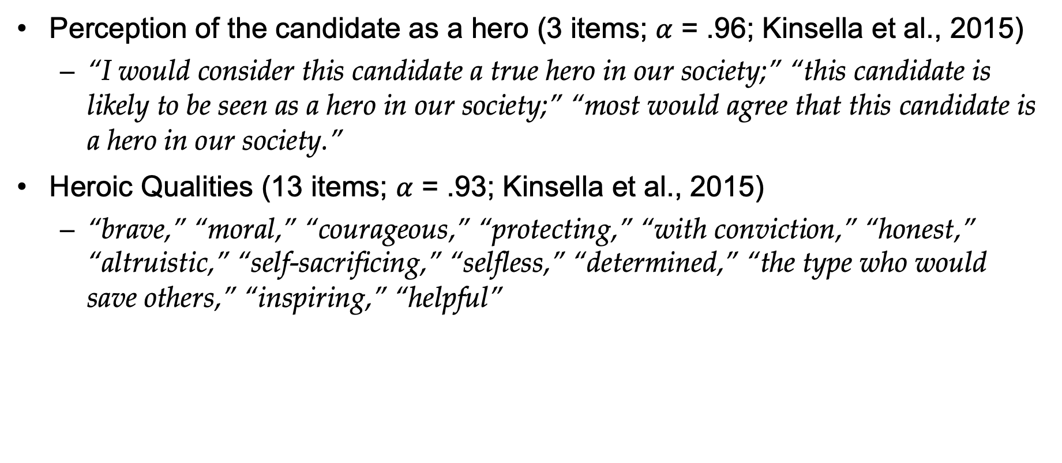
EXP 2 Measures
Perception of the candidate as a hero (3 items; $α$ = .96; Kinsella et al., 2015)
“I would consider this candidate a true hero in our society;” “this candidate is likely to be seen as a hero in our society;” “most would agree that this candidate is a hero in our society.”
Heroic Qualities (13 items; $α$ = .93; Kinsella et al., 2015)
“brave,” “moral,” “courageous,” “protecting,” “with conviction,” “honest,” “altruistic,” “self-sacrificing,” “selfless,” “determined,” “the type who would save others,” “inspiring,” “helpful”

Slide 34
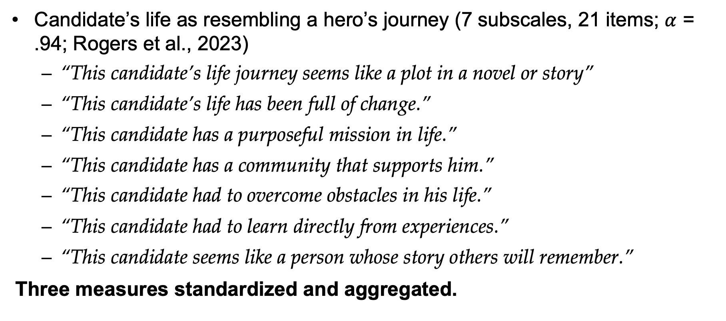
EXP 2 Measures
Candidate’s life as resembling a hero’s journey (7 subscales, 21 items; $α$ = .94; Rogers et al., 2023)
“This candidate’s life journey seems like a plot in a novel or story”
“This candidate’s life has been full of change.”
“This candidate has a purposeful mission in life.”
“This candidate has a community that supports him.”
“This candidate had to overcome obstacles in his life.”
“This candidate had to learn directly from experiences.”
“This candidate seems like a person whose story others will remember.”
Three measures standardized and aggregated.

Slide 35
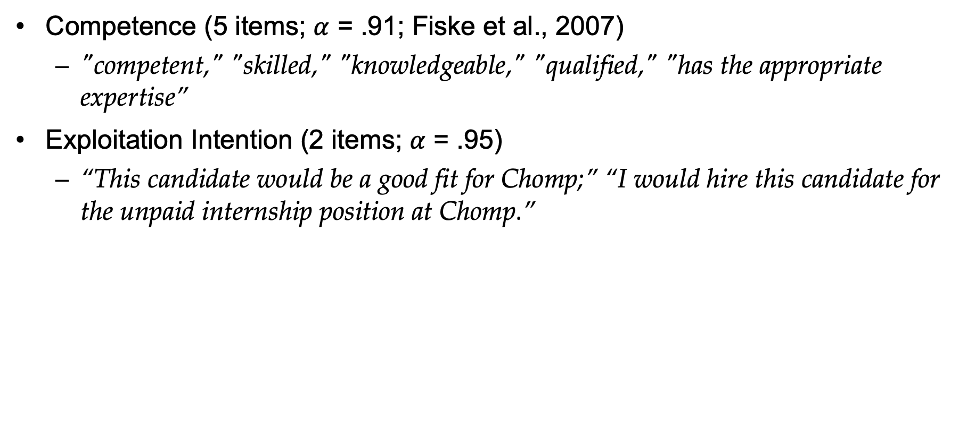
EXP 2 Measures
Competence (5 items; $α$ = .91; Fiske et al., 2007)
"competent," "skilled," "knowledgeable," "qualified," "has the appropriate expertise”
Exploitation Intention (2 items; $α$ = .95)
“This candidate would be a good fit for Chomp;” “I would hire this candidate for the unpaid internship position at Chomp.”

Slide 36
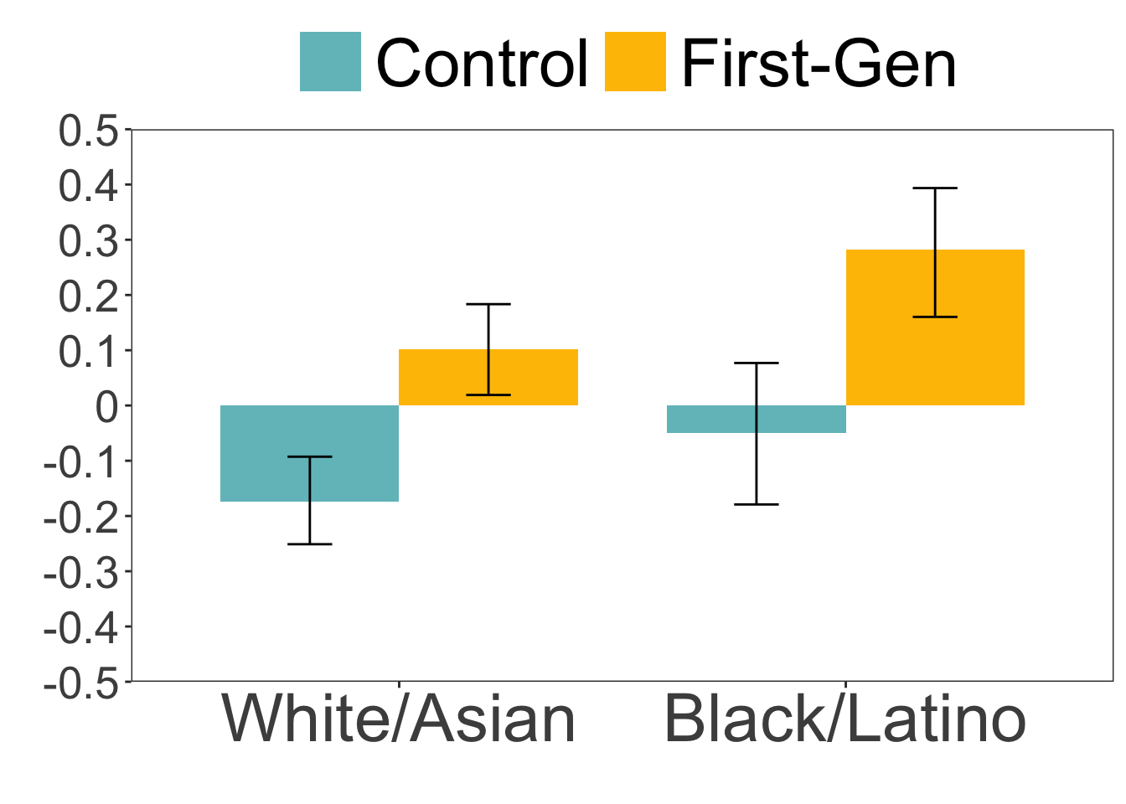
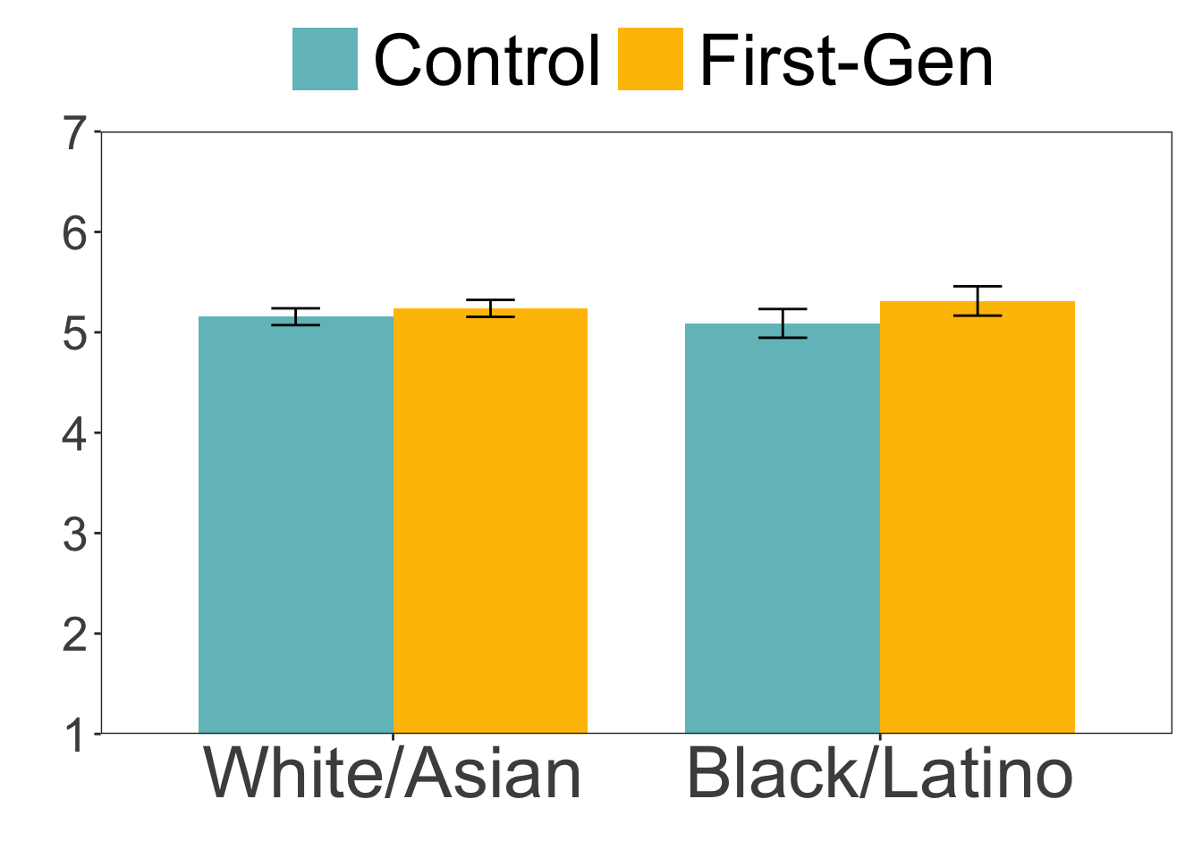
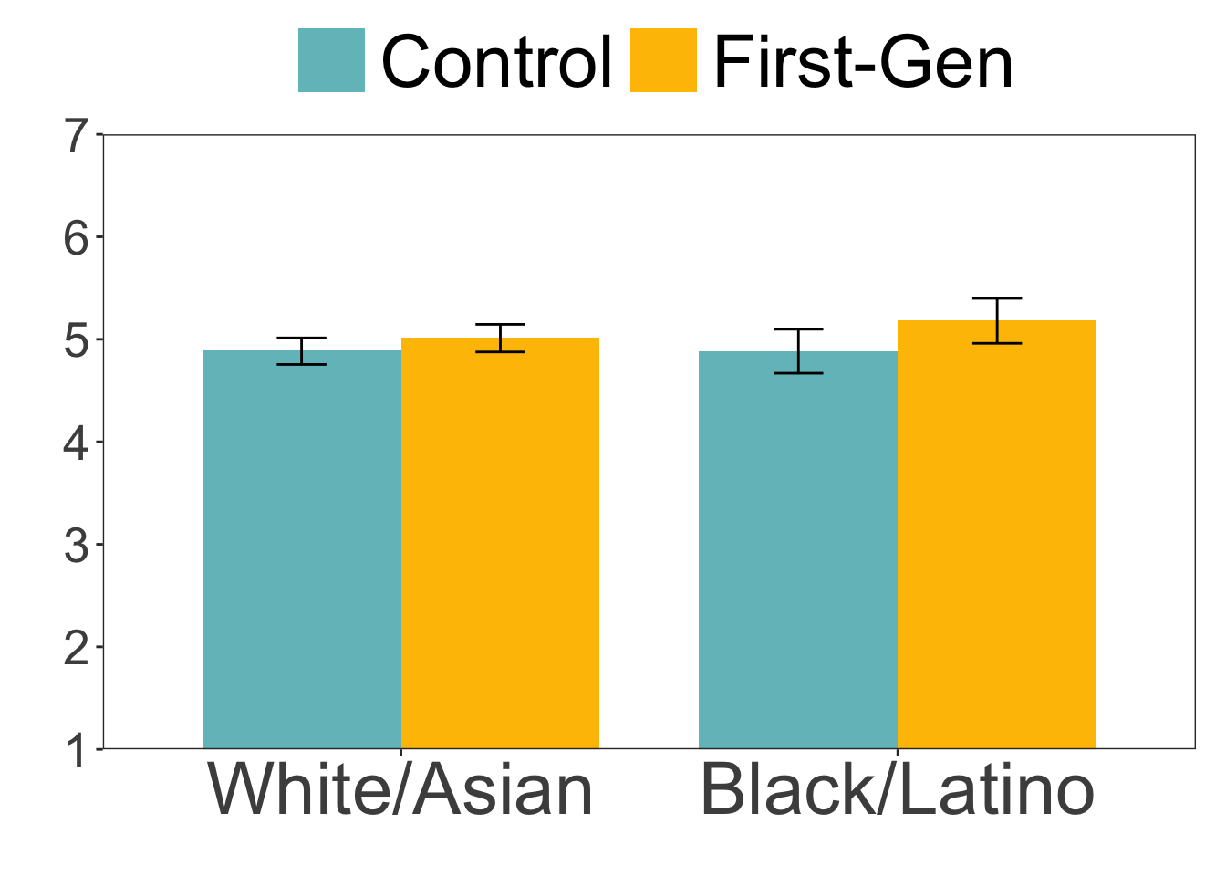
EXP 2 Results
Hero (composite)
Competence
Exploitation
First-gen: b = 0.15, SE = 0.03, t(1231) = 5.34, p < .001
URM: b = 0.08, SE = 0.03, t(1231) = 2.69, p = .007
Interaction: b = 0.01, SE = 0.03, t(1231) = 0.49, p = .627
First-gen: b = 0.08, SE = 0.03, t(1231) = 2.41, p = .016
URM: b = 0.002, SE = 0.03, t(1231) = 0.06, p = .955
Interaction: b = 0.04, SE = 0.03, t(1231) = 1.14, p = .257
First-gen: b = 0.11, SE = 0.05, t(1231) = 2.27, p = .023
URM: b = 0.04, SE = 0.05, t(1231) = 0.87, p = .384
Interaction: b = 0.05, SE = 0.05, t(1231) = 0.94, p = .345
Indirect effect: First-gen (vs. control) → Heroization → Exploitation, 95% CI [0.04, 0.09]

Slide 37
Experiment 3 (Audit Study)
N = 1,106 applications to unpaid internship positions
February 19 to June 15, 2024
Indeed, Career Builder, Monster.com
20 metropolitan areas in the U.S.
excluded jobs that required specialized training (e.g., certification, programming languages)
2 (candidate status: First-Gen vs. Control) × 4 (candidate race: Asian vs. Black vs. Latino vs. White) between-subjects design
DV: callback (0 = no callback/rejection, 1 = invited via phone call or email for a follow-up interview)

Slide 38
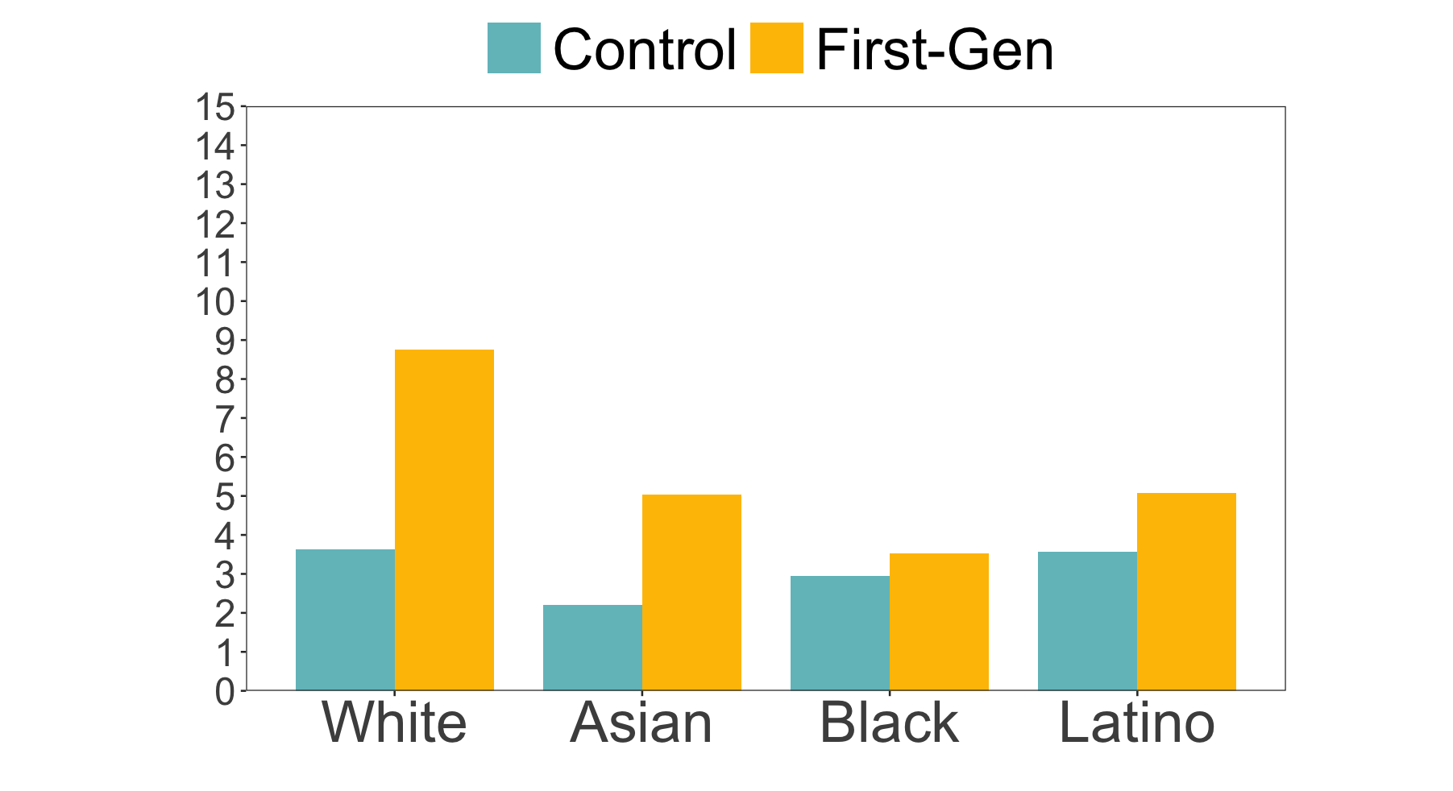
EXP 3 Results
4% (48/1,106)
Callback Rate (%)
+
n.s.
n.s.
n.s.
First-gen: b = 0.30, SE = 0.16, z = 1.90, p = .057
URM: b = -0.10, SE = 0.16, z = -0.62, p = .534
Interaction: b = -0.15, SE = 0.16, z = -0.99, p = .323
Notes:
Controlling for type of job, type of organization, and region
Impact of Low Event Rate (4% Y = 1)
When only 4% of the observations have Y=1Y = 1Y=1 (and 96% have Y=0Y = 0Y=0), the situation is known as a "rare event" scenario. Here's how this low proportion affects your analysis:
Reduced Statistical Power:
Lower Variability: With only 4% of events, the variability in YYY is lower, which means there is less information to distinguish between different values of XXX. This reduces the ability of the model to detect a significant relationship between XXX and YYY.
Smaller Effective Sample Size: Even if you have a large overall sample size, the effective sample size for the Y=1Y = 1Y=1 group is small. Power calculations are sensitive to the number of events; fewer events generally lead to lower power.
Increased Uncertainty in Estimates: The logistic regression coefficients (odds ratios) related to Y=1Y = 1Y=1 will have larger standard errors due to the low number of events. This makes it harder to achieve statistically significant results.

Slide 39
Summary
People perceive first-gens as more heroic than continuing-gens
People prefer to hire first-gens (vs. continuing-gens) more for unpaid internship positions—effect seems strongest among white candidates

Slide 40
Incompetence
Lacking Cultural Fit
Heroes
exploitation
Industrious
funneling?
Notes:
Deficit models are problematic, but overly romantized views hurt too

Slide 41
When evaluating those from lower social class origins, deficit models are problematic
But overly romanticized views hurt too!!!
→ exploitation
→ funneling into low-status positions

Slide 42



Katharine Chang
Roma Farooqui
Peter Belmi
Thank you!
Questions and comments to:
Shuang Wu
shuang.t.wu@rady.ucsd.edu

